Slide 1
PLATO
(PLAY – TOE)

Slide 2
WHY PLATO?
politics is the way that people living in groups make decisions.
Plato wrote a LOT of books. He wrote a lot about Socrates.
Plato’s books had lots of “funny” characters.
Plato had a lot of ideas about politics.
Plato had some interesting ideas about where truth comes from.
Plato wrote the famous Allegory of the Cave – we’ll learn more about that soon!
Notes:
Plato wrote a lot of books and almost all of them survived (a lot of ancient work has been destroyed by fire, religious zealots and battles)
He made Socrates famous.
He wrote well and included ‘funny’ characters in his work.
He came up with a lot of political theory (all the ‘ocracies have been written about in a book called The Republic.
He had some very interesting ideas about where truth comes from.
He came up with The Allegory of the Cave which you will look at in today.

Slide 3
WRESTLER
PHILOSOPHER
TEACHER
WHO WAS
PLATO?
Plato lived in Athens, Greece.
Plato was born in 428BCE and died in 348BCE – he was 80 when he died.
THE ACADEMY
Notes:
Plato was born in 428BCE and died in 348BCE – he was 80 when he died.
He taught many people including another famous philosopher, Aristotle (for about 20 years)
He opened a place of learning called ‘The Academy’ which was open on and off for almost 900 years after his death.
He lived in Athens, in Greece.
He wrote extensively.
Plato was a well-known wrestler. His name means “broad shoulders” and was actually his wrestling name (his proper name was Aristocles)!

Slide 4
3
Click here to open in browser
Notes:
Why was he famous?
Please mute your mic and watch this clip – it is about 3 minutes long…
I will ask you all questions about it in the Chat afterwards.

Slide 5
WHAT DID HE DO?
Plato thought philosophers should reveal the truth.
He argued that philosophers know what others don’t, so they should be educators.
The philosopher has a similar role to that of religious prophets.
Plato valued philosophy so much he said philosophers should be kings!
Notes:
Plato thought that the role of the Philosopher was to reveal the truth to people who were otherwise clueless!
In other words the Philosopher knew what other didn’t and it was his job to educate them.
This role of Philosopher is the same for the Prophet (Muhammad, Moses, Elijah, Jesus) and the visionary (John – the Book of Revelations)
Plato believed so much in the value of Philosophy that he said that Philosophers should be Kings!

Slide 6
PHILOSOPHER KINGS
THE PHILOSOPHER
The cleverest person does all the thinking for society.
ADMINISTRATORS
Ruled by the philosopher, they are like the lungs and heart of the people.
ARMY AND WORKERS
Like the arms of the community, controlled by the administrators.
DISCUSSION POINT
Plato, a philosopher, thinks that philosophers should be in charge…I wonder who you think should be in charge today?
Notes:
How does the idea of a philosopher king work?
Well, the Philosopher, the cleverest and most educated person in the city would be like the Head and do all the thinking.
He would then rule over the administrators, who would be like the lungs and heart.
They would control the hands and arms (The army and the workers)
Something to bear in mind when thinking about this is that Plato, a philosopher, thinks that Philosophers should be in charge…I wonder who you think should be in charge today?

Slide 7
PLATO AND THE SOUL
Souls are eternal and know all things.
Knowledge is locked away when we are born.
Learning reminds us of knowledge our souls have.
We forget what our souls know.
Notes:
For Plato the heavens were full of the eternal things and the soul was one of those things.
It arrived on earth in your newly born body and knew ALL things….but the body gets in the way.
If you just listen, learn and think then all that knowledge will come back to you…
If you don’t, it won’t!
Some people can learn and some people can’t…

Slide 8
PLATO AND THE WORLD
Notes:
For Plato and his followers the world was something to live through…
Heaven was somewhere to get back to…
This idea influenced Christians and their ideas about the afterlife….
It also led to a lot of people accepting that this life might be rubbish and they might have a rubbish place in it.
That they should also not worry about this world was a very catchy idea….
It makes it easier to live through all the hard times if you know they don’t matter…

Slide 9
The part can never be well unless the whole is well.
Notes:
Here are some of Plato’s most famous quotes…though there are many more!

Slide 10
If a man neglects education, he walks lame to the end of his life.

Slide 11
Those who tell the stories rule society.

Slide 12
A house that has a library in it has a soul...

Slide 13
Tyranny naturally arises out of democracy.

Slide 14
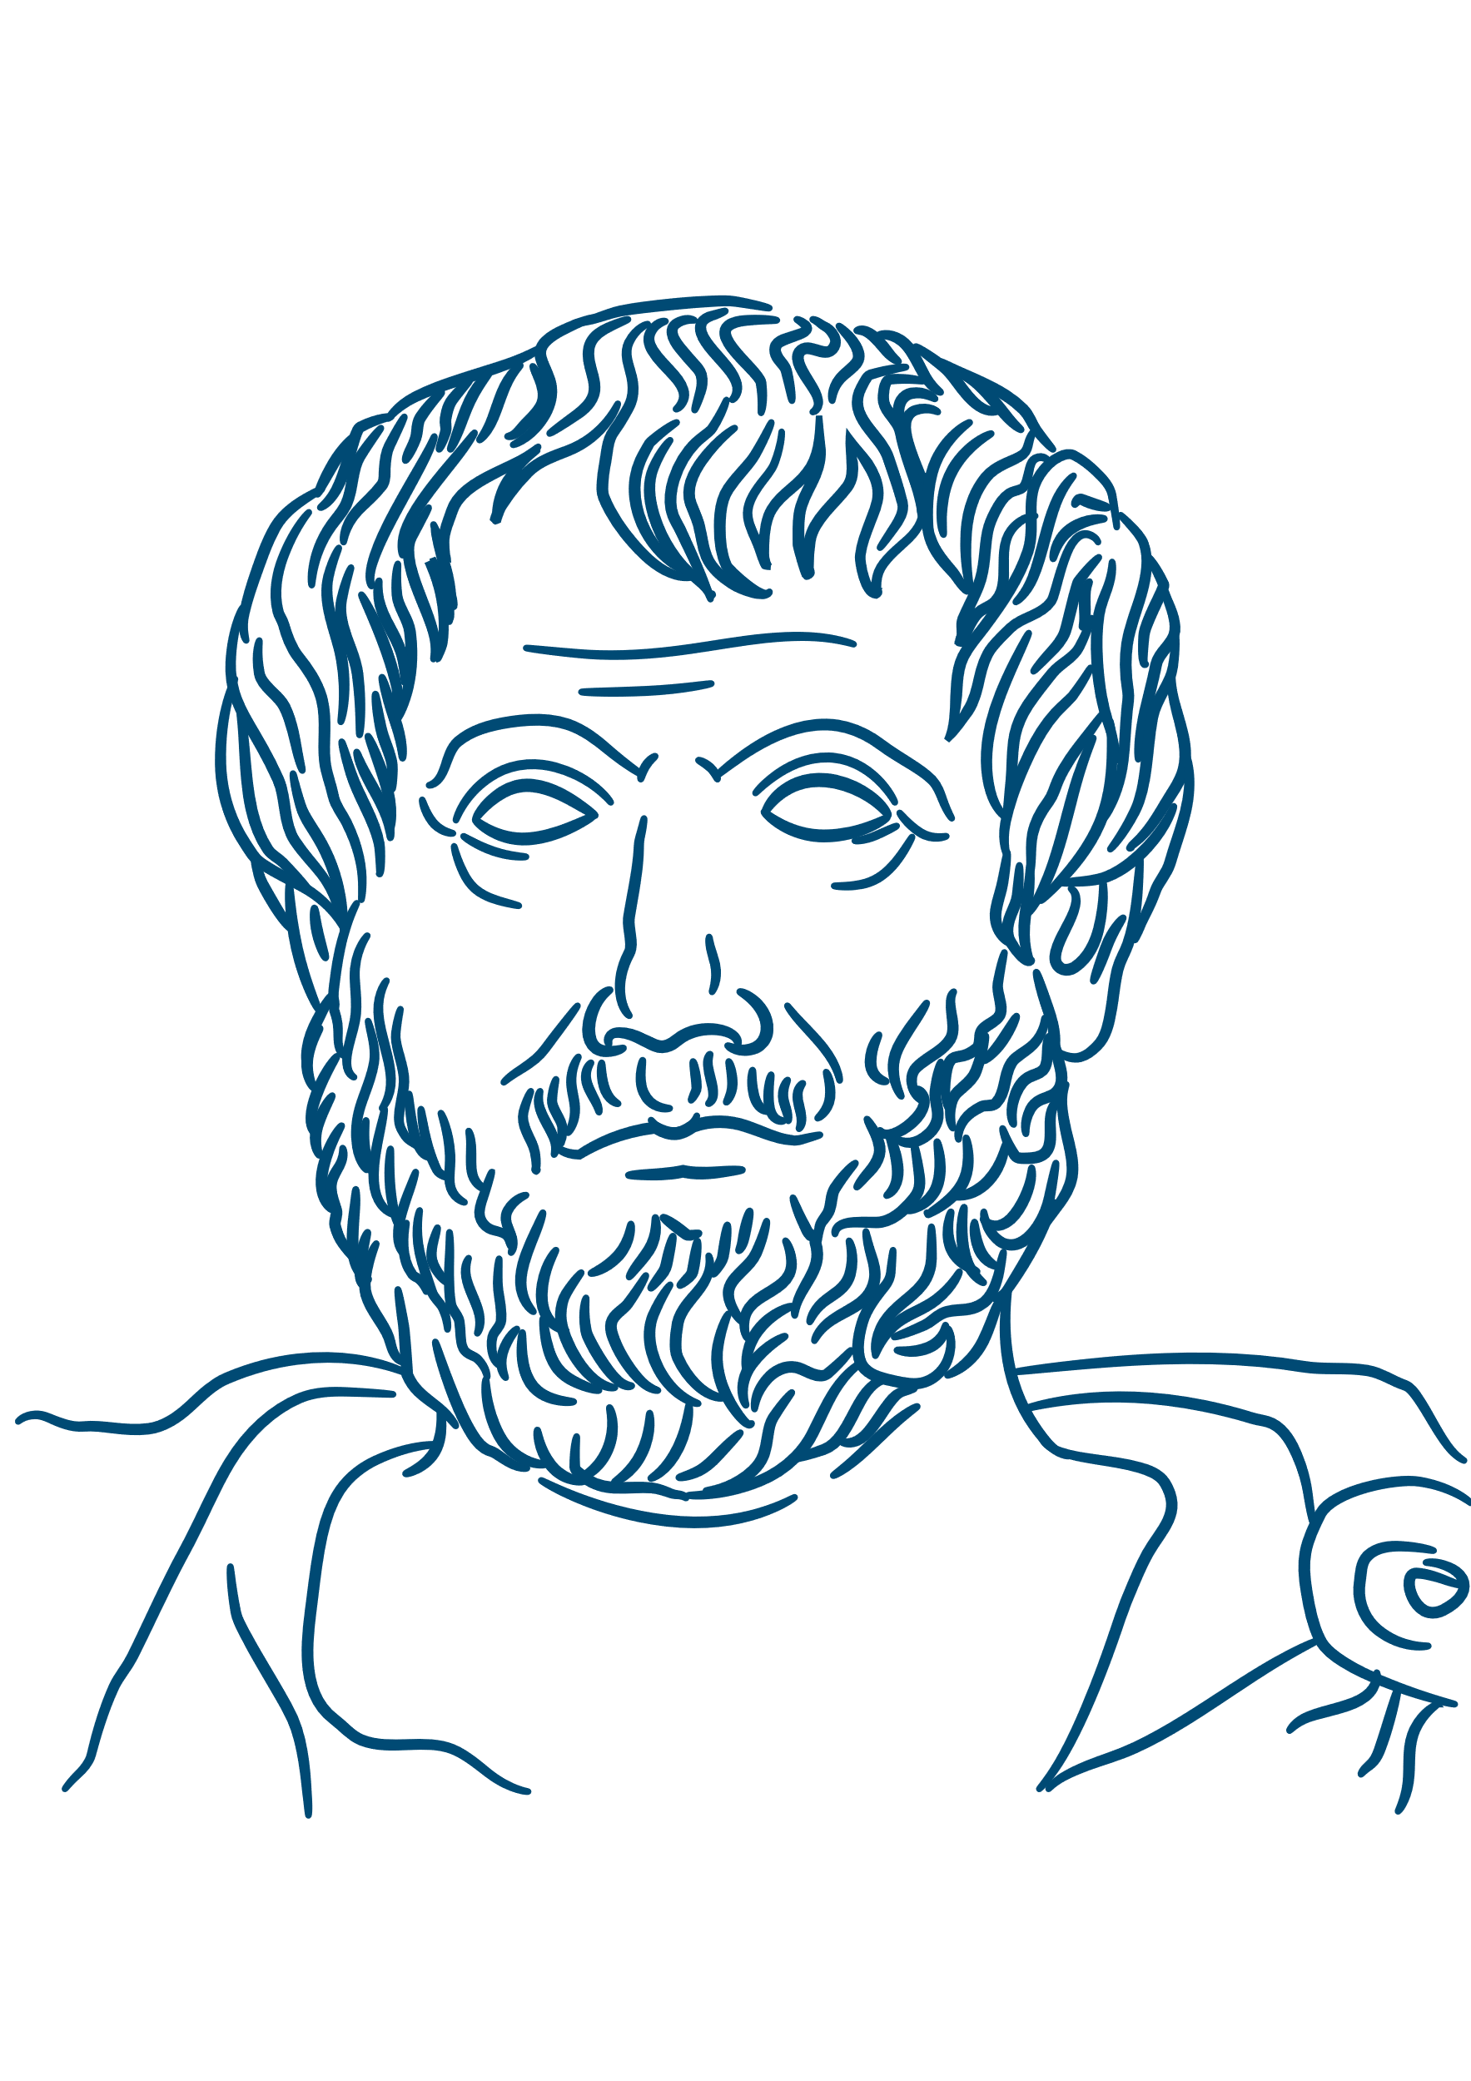
PLATO AND ARISTOTLE
Notes:
Plato was the teacher and hoped to take over the Academy.
When Plato died it was left to someone else and so Aristotle packed up and left!
As a result his philosophy could not be more different from Plato’s work. This was great for Science…We’ll look at Aristotle next week.

Slide 15
End of slide show

Slide 16
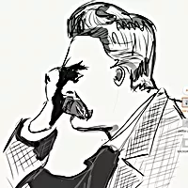
Author
For resources, lessons and more, visit https://www.philosophyinks2.co.uk
Mr Semmens
Design
Mr Stevenson

