Slide 1
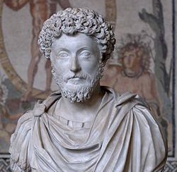
Marcus Aurelius
Stoicism – Mental Health, Philosophy and RE
This Photo by Unknown Author is licensed under CC BY-SA

Slide 2
Why Marcus Aurelius?
Aurelius was a stoic.
Stoicism is built on 4 principles:
Moderation
Wisdom
Courage
Justice
He was a Roman Emperor and focused on how to live a ‘good life’
He talks about a way to lead life without fear, worry and sadness.

Slide 3
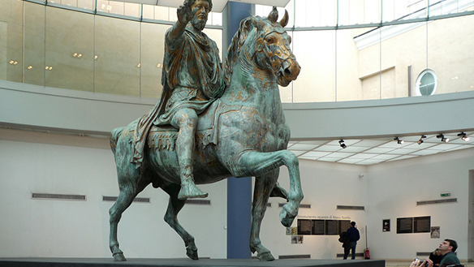
Who? When?
"[The emperor's] Stoic philosophy – which is about self-restraint, duty, and respect for others – was so abjectly abandoned by the imperial line he anointed on his death.” Historian Iain King.
Marcus Aurelius: born 26 April 121 – died 17 March 180 AD
known as the last of the ‘Good Emperors’
Was hailed as a Philosopher King in his lifetime.
He was probably a better philosopher than he was a father as his heir. Commodus was a terrible Emperor.
This Photo by Unknown Author is licensed under CC BY-SA-NC

Slide 4
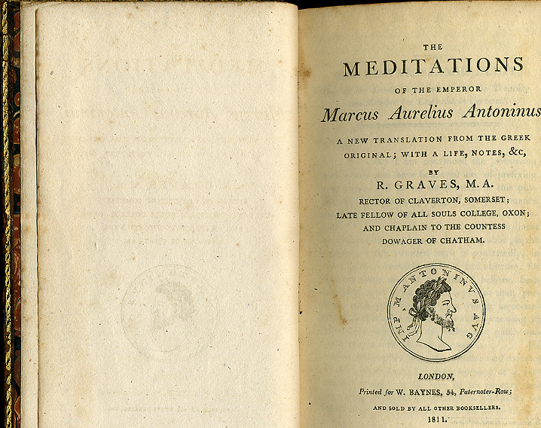
Why is he famous?
His most famous work The Meditations features many of the major ideas of his stoicism.
It teaches us to:
find calm
Take control over our own minds
Look for the beautiful things in life.
Stoicism didn’t start with Aurelius but it was certainly perfected by him….
This Photo by Unknown Author is licensed under CC BY-SA

Slide 5
Why did he do it?
Stoicism started with Zeno of Citium of Athens, in city square called Stoa Poikile where we get it’s name.
The famous Stoics put aside their need to be what society wanted them to be and found ways to abandon feelings like worry and sadness.
Other famous stoics include: Diogenes (more about him later), Seneca the Younger and Epictetus but Marcus Aurelius was the last of them – although it has remained a popular philosophy since his death.

Slide 6
How did he do it?
He said:
“Waste no more time arguing what a good man should be. Be one.”

Slide 7
10 Rules for Living
Gratitude
Be grateful. (keeping a gratitude journal)
Empathy
Show empathy (understand why someone has done wrong things to you.
Mindfulness
Be mindful (be systematic in your thinking and stop caring about what other people do and say.
Virtue
Practice Virtuousness (be a good person even if no one notices – be honest, brave and kind.
Contribute
Willingly contribute (do good deeds and work)

Slide 8
10 Rules for Living (continued…)
Revenge is not necessary (“The best revenge is not to be like your enemy”)
Have patience (control your reactions to stressful things)
Maintain Social Relationships (have friends and family, form friendships and maintain contact with them).
Be genuine, modest, serene and truthful (be true to yourself and others)
Accept and appreciate yourself (love who you are and stop worrying about what others think of you – you can’t control that)

Slide 9
What is his legacy? (What is still important?)
People are still living their lives according to his rules.
The are used by business leaders, celebrities, teachers and people who have previously suffered from mental illness.
They are used by people who are going through a difficult time (like right now)
They are used by people who want to be better at life.

Slide 10
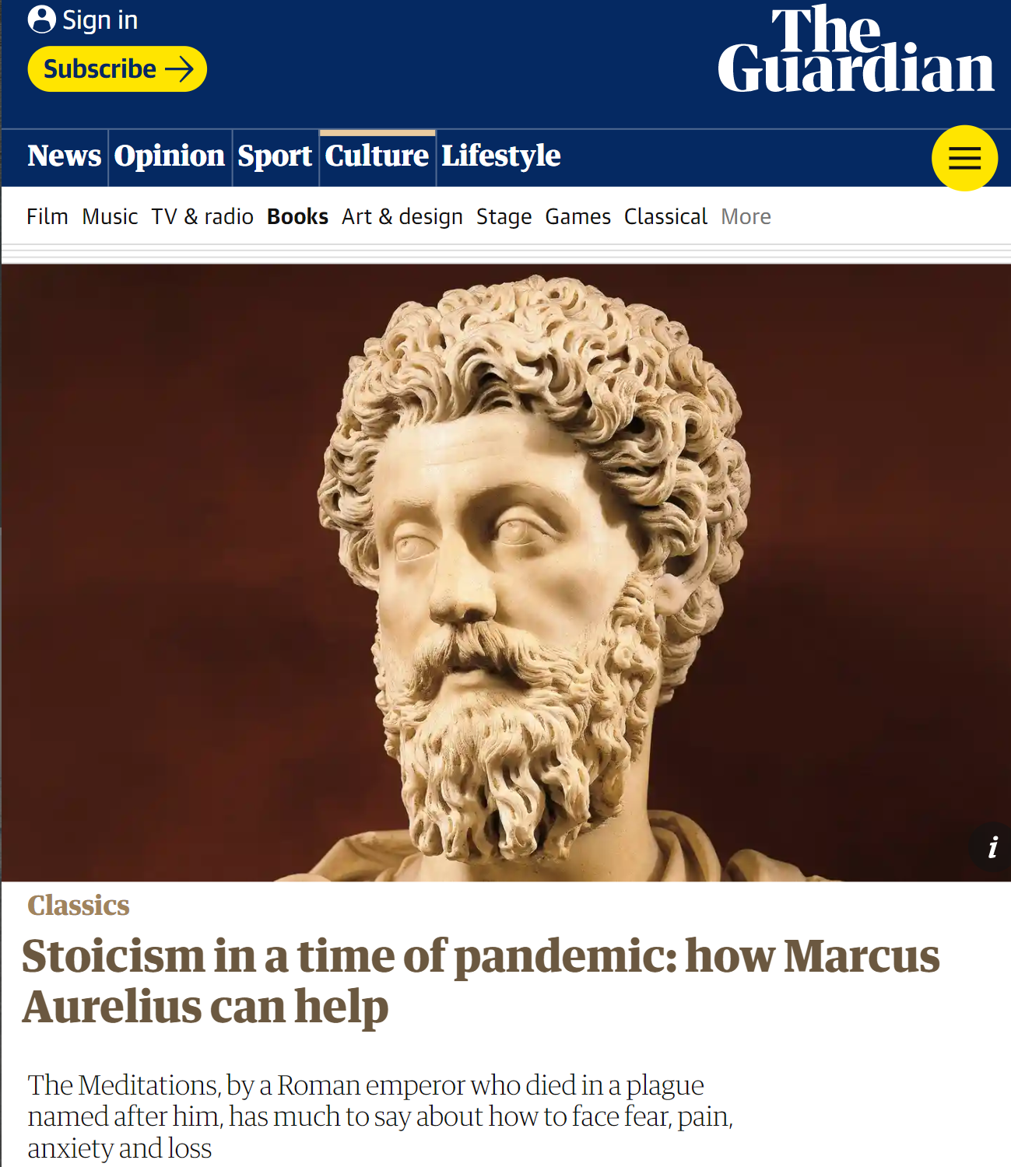

Slide 12
WE LIVE ONLY NOW. EVERYTHING ELSE IS EITHER PASSED OR IS UNKNOWN.
HOW RIDICULOUS AND HOW STRANGE TO BE SURPRISED AT ANYTHING WHICH HAPPENS IN LIFE.
LIVE OUT YOUR LIFE IN TRUTH AND JUSTICE, TOLERANT OF THOSE WHO ARE NEITHER TRUE NOR JUST.

Slide 13
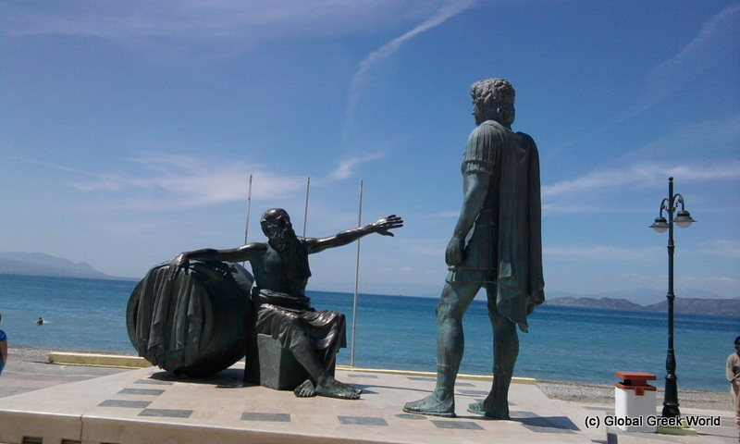
What about the other Stoics?
Diogenes slept in a wine barrel
Went to the toilet wherever he liked
Walked around holding a lamp in the middle of the day claiming he was ‘looking for an honest man.’
Told Alexander the Great to get out of his sunlight!
This Photo by Unknown Author is licensed under CC BY-SA-NC

Slide 14
What can we learn from Stoicism?
Be grateful. (keeping a gratitude journal)
Show empathy (understand why someone has done wrong things to you.
Be mindful (be systematic in your thinking and stop caring about what other people do and say.
Practice Virtuousness (be a good person even if no one notices – be honest, brave and kind.
Willingly contribute (do good deeds and work)
Revenge is not necessary (“The best revenge is not to be like your enemy”)
Have patience (control your reactions to stressful things)
Maintain Social Relationships (have friends and family, form friendships and maintain contact with them).
Be genuine, modest, serene and truthful (be true to yourself and others)
Accept and appreciate yourself (love who you are and stop worrying about what others think of you – you can’t control that)

