Slide 1
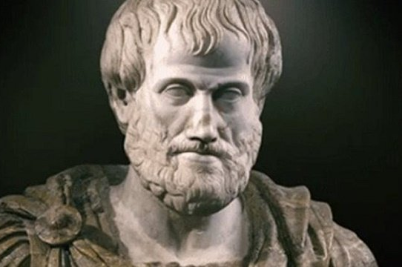
The Great Philosophers: Aristotle
What can we learn from the Great Philosophers?
This Photo by Unknown Author is licensed under CC BY
This Photo by Unknown Author is licensed under CC BY-SA

Slide 2
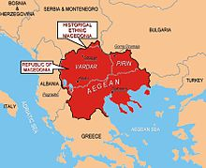
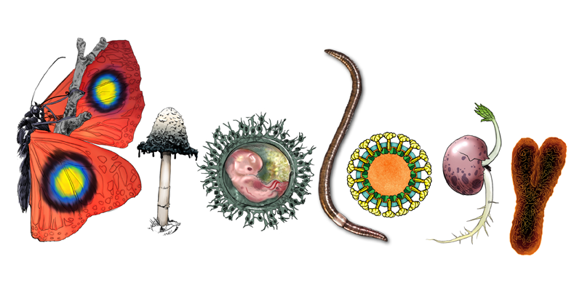
Why Aristotle?
Aristotle bought a logical way of thinking to everything he studied.
He pulled everything apart, categorized it and studied it properly.
He was an immigrant to Athens (from Macedonia) and had to leave Athens twice.
He wrote about literature (how to write and read), ethics (how to live), physics (how the universe works) and in order to study animals and how the natural world worked he had to INVENT BIOLOGY!
Almost all of his work is used in all of these fields of study.
This Photo by Unknown Author is licensed under CC BY-SA

Slide 3
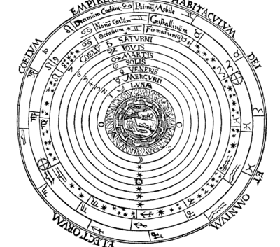
What’s the use of Philosophy?
This Photo by Unknown Author is licensed under CC BY-SA-NC
Socrates – freed people from their old ideas about superstition, magic, false gods, monsters and encouraged people to think things through….
Plato – focuses people on these ideas, getting rid of nonsense and properly thinking about how the world (the city) should work. He also thought about idealism and perfection and that we should strive towards an understanding of that perfection.
Aristotle – wrote the Poetics – this is still used today by Hollywood scriptwriters, Wrote the Physics – this was the basis for all understanding about the Cosmos, Wrote the Nicomachean Ethics – people still study this to workout how to live a good life. INVENTED BIOLOGY!
This Photo by Unknown Author is licensed under CC BY-SA

Slide 4
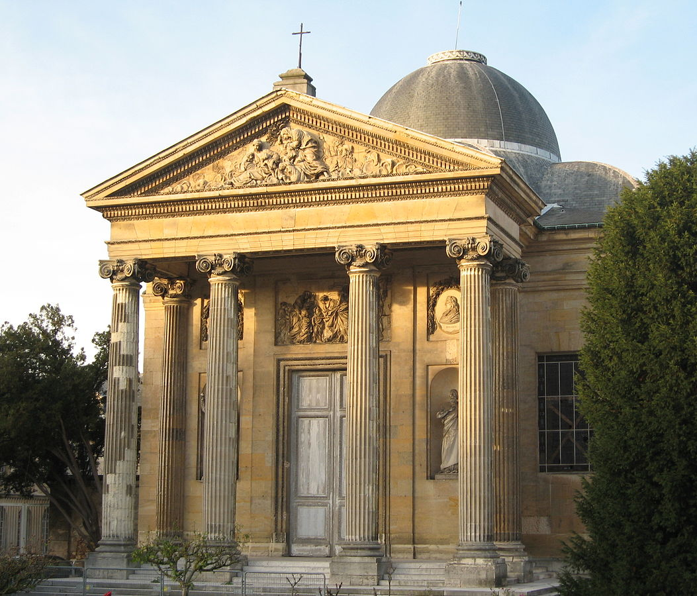
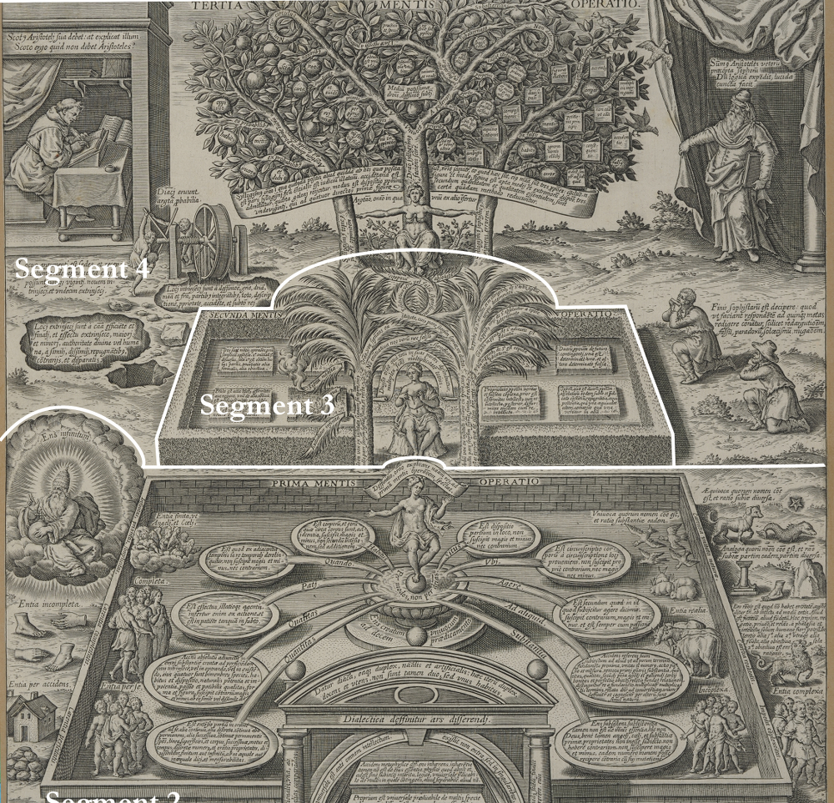
Aristotle: Who? When?
Aristotle was born in 384BCE in Stagira (now Macedonia)
He taught many people – most famously Alexander the Great.
He was taught by Plato and hoped to one day inherit the Academy from him. Plato died leaving the Academy to his nephew and Aristotle left Greece in shame.
He opened his own school called the Lyceum (which is what the French call their upper secondary schools - lycée)
He wrote so much but only a few of his works survive and a lot of his lecture notes.
This Photo by Unknown Author is licensed under CC BY-SA-NC
This Photo by Unknown Author is licensed under CC BY-SA

Slide 5
A hard fact…

Slide 6
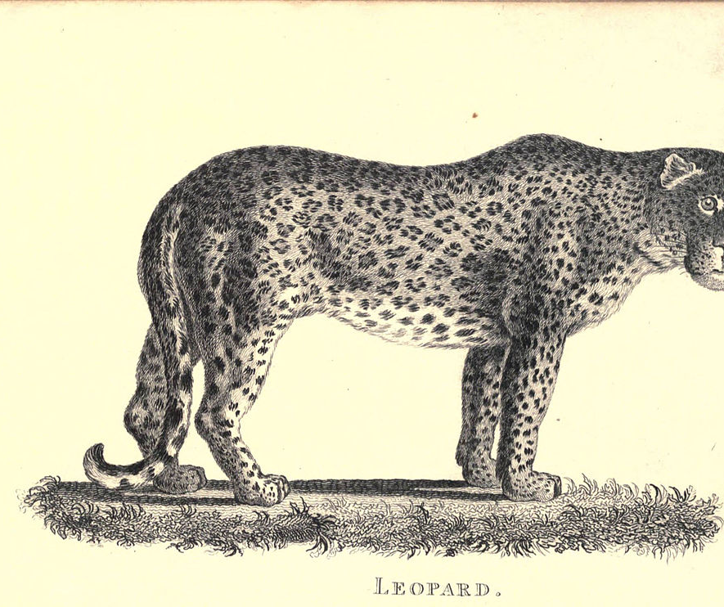
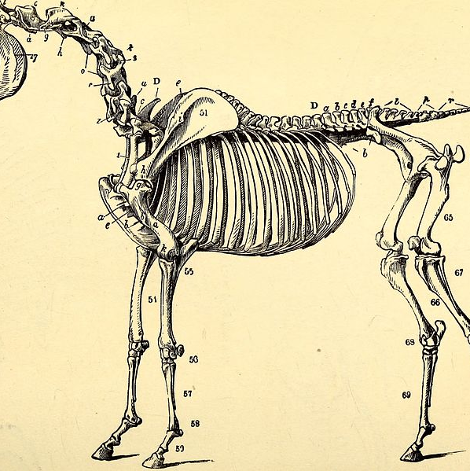
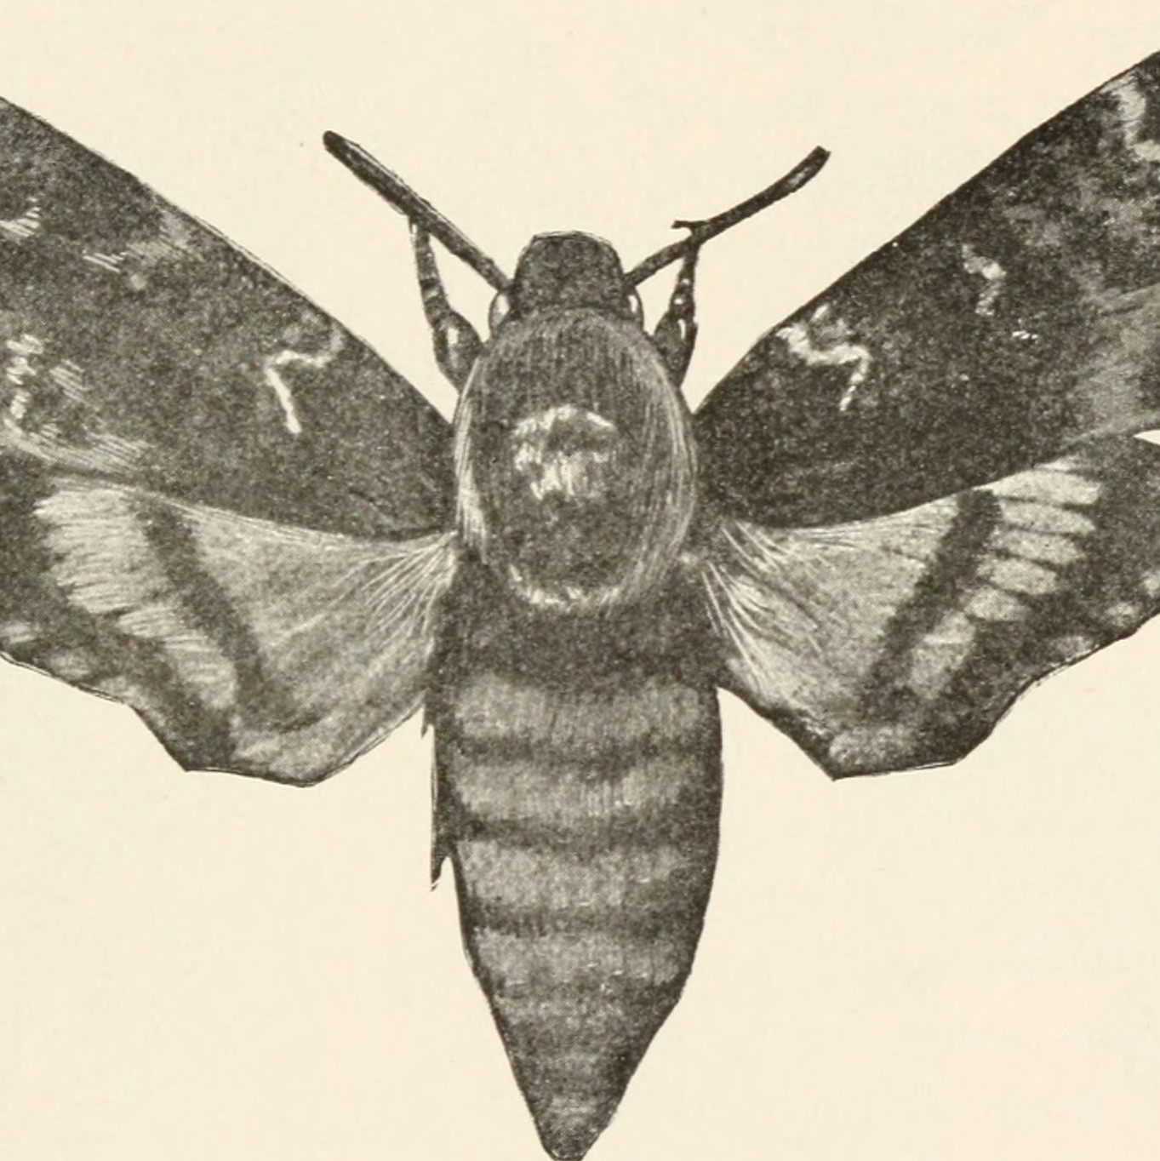
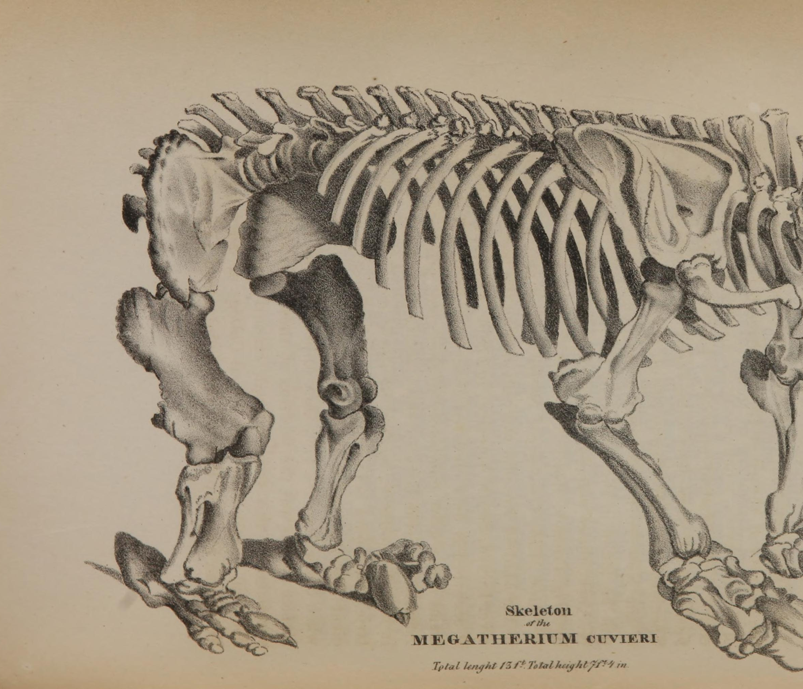
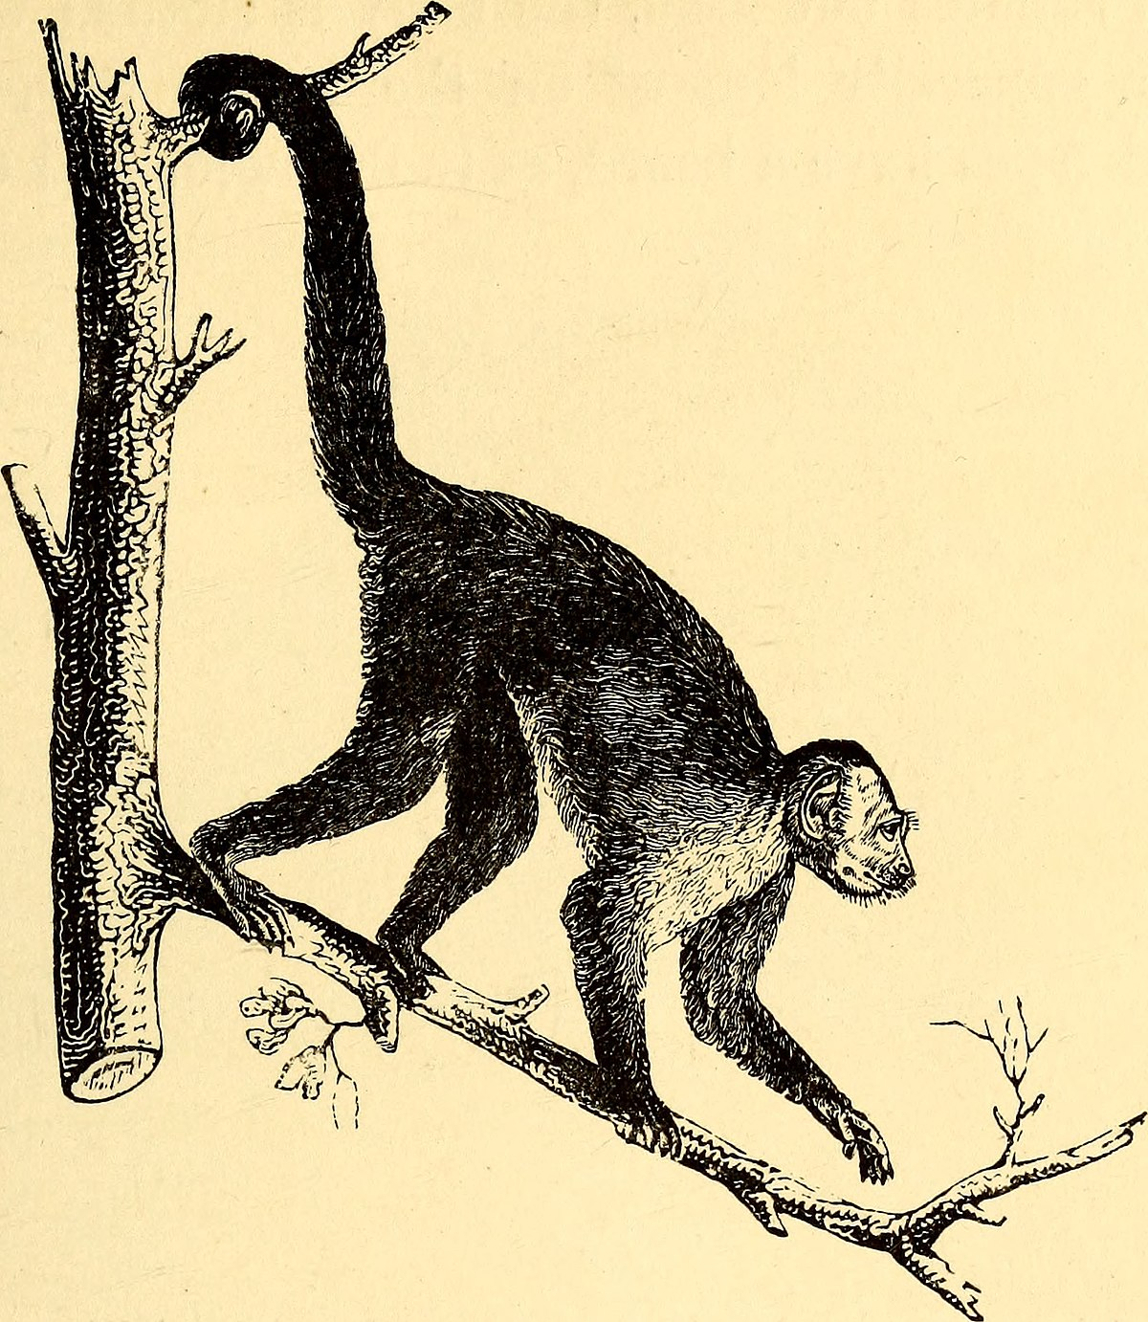
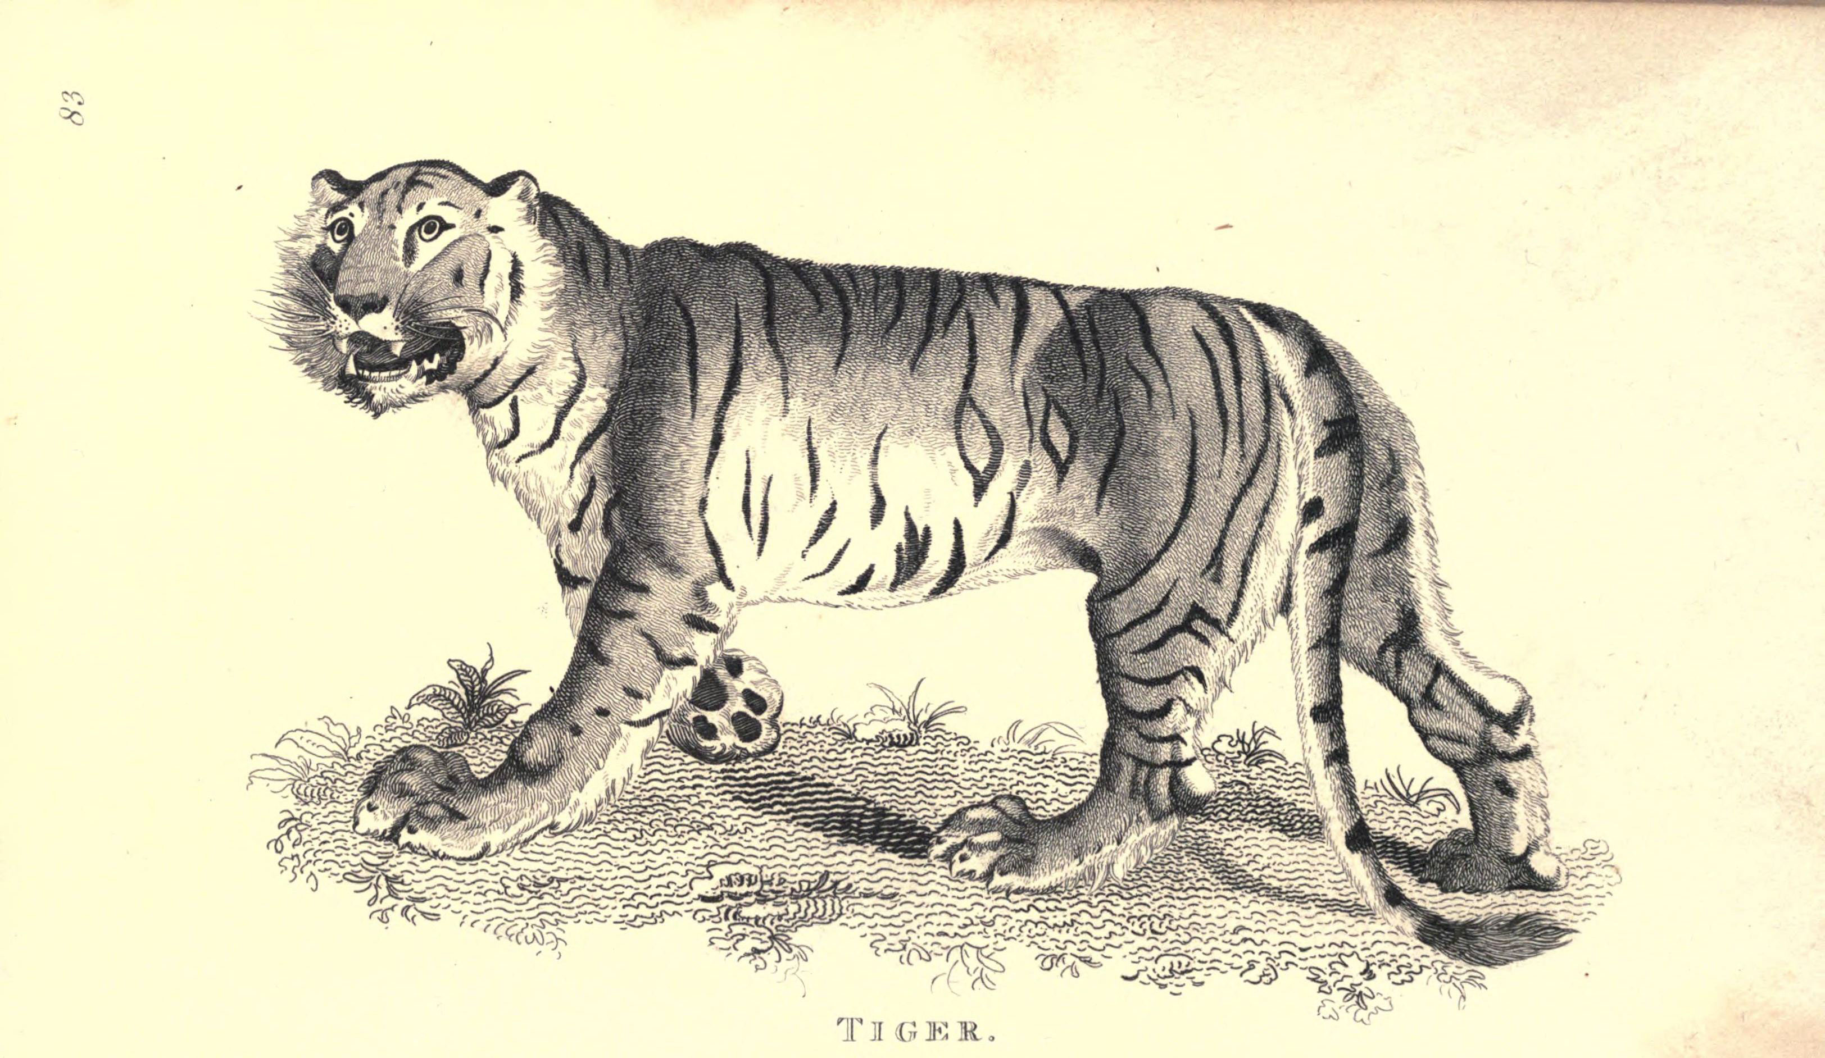
Why was he famous?
I am going to look at two major ideas that we have from Aristotle…categorizing animals and Literature.
Zoology – Aristotle looked closely at animals and wrote about them in detail.
He would dissect animals in order to find out how they worked.
He was find out from others about the habits of animals he had never seen – this lead him to get a lot of things totally wrong!

Slide 7
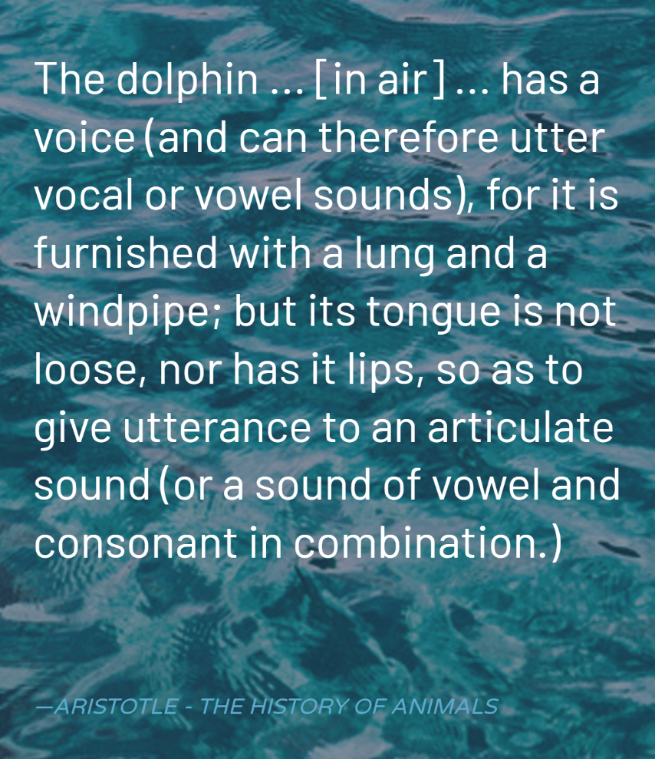
Gottle of geer!
This Photo by Unknown Author is licensed under CC BY-SA

Slide 8
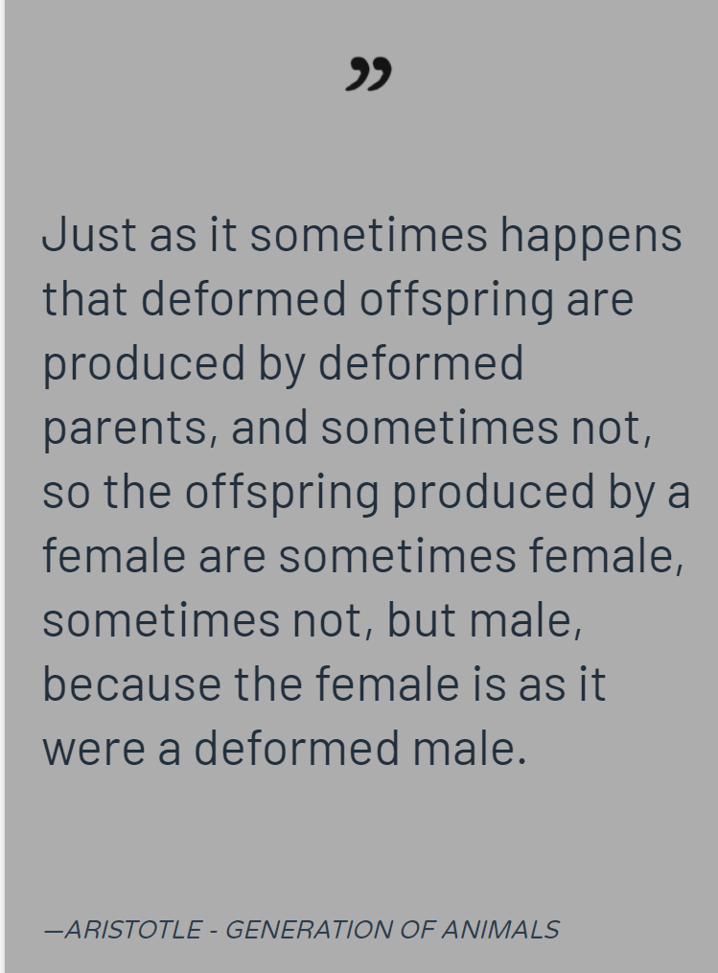
Half right – half totally wrong!
Here Aristotle talks about genetic problems passing from one animal to it’s babies.
This is amazingly ahead of it’s time!
He then ruins it by saying that Females are deformed Males! Doh!
This Photo by Unknown Author is licensed under CC BY

Slide 10
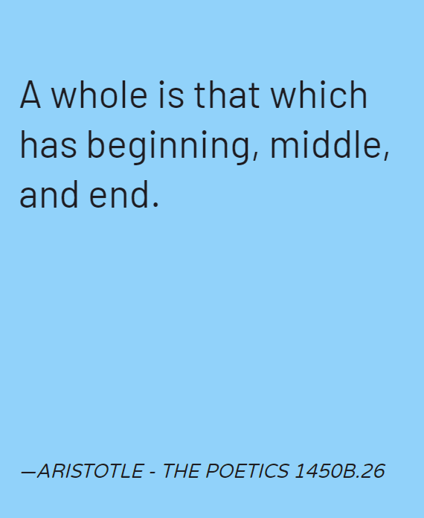
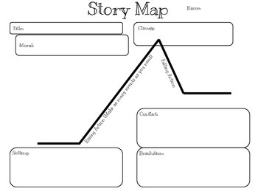
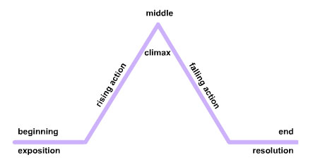
The Poetics – the study of literature
This Photo by Unknown Author is licensed under CC BY-SA
This Photo by Unknown Author is licensed under CC BY-NC
Aristotle was the first to study good stories and plays and dissected them like he did his animals.
He pulled them apart to see what they were made of.
He is where we get our plot mountain from and the most basic of story structures….

Slide 11
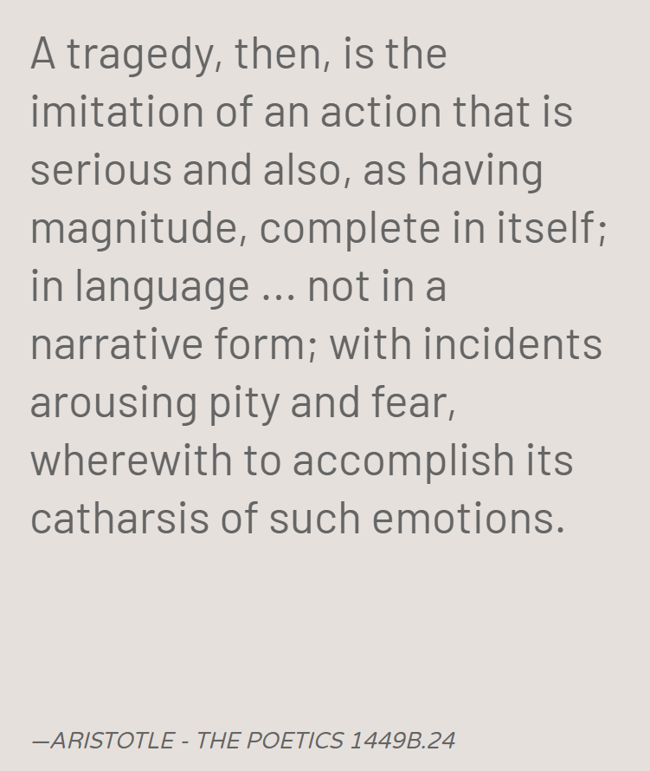
Catharsis
Catharsis is the idea of sympathising with characters and feeling their emotions – then crying or laughing or feeling scared to get rid of the excess emotions you might have.
So if you’re feeling very sad watch a sad film, have a cry and let it all out!
Or if you’re feeling sorry for yourself watch a film about someone worse off – pour your pity on that character.
This Photo by Unknown Author is licensed under CC BY-SA
This Photo by Unknown Author is licensed under CC BY-SA

Slide 12
Over to you…What do you think these quotes mean?
…Honour truth above our friends.
It is simplicity that makes the uneducated more effective than the educated when addressing popular audiences.
Man, when perfected, is the best of animals, but when separated from law and justice, he is the worst of all.

Slide 13
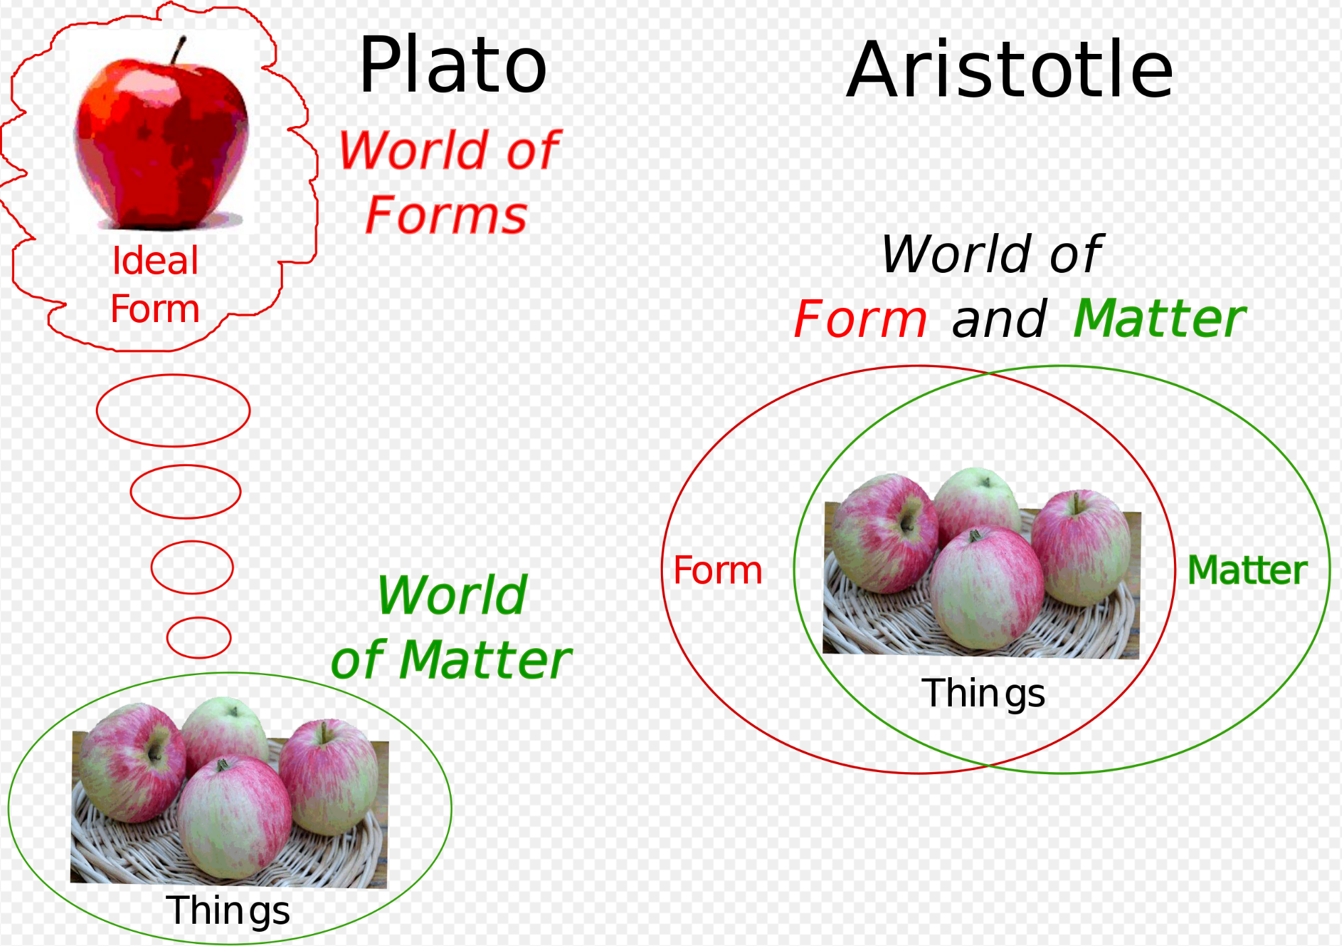
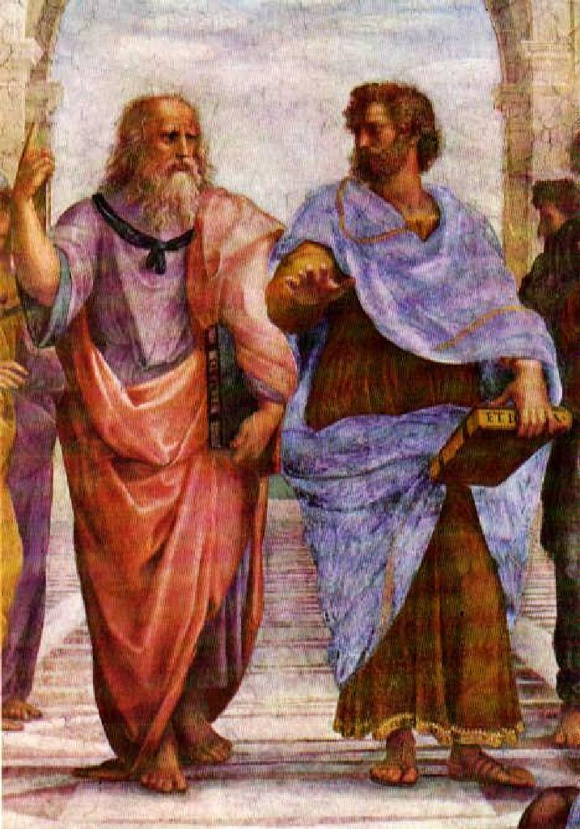
His split from Plato resulted in a totally different way of seeing the world….
Edith Hall – Classics professor at Kings College London believes that Plato had terrible eyesight, so when he saw things he thought about the perfect version, in his head…He then reasoned that this perfect version comes from the Realm of the Forms (a heavenly eternal place)
Hall goes on say that she believes that Aristotle’s vision was perfect and so he looks at the world for what it really is…
This Photo by Unknown Author is licensed under CC BY
This Photo by Unknown Author is licensed under CC BY-NC-ND

Slide 14
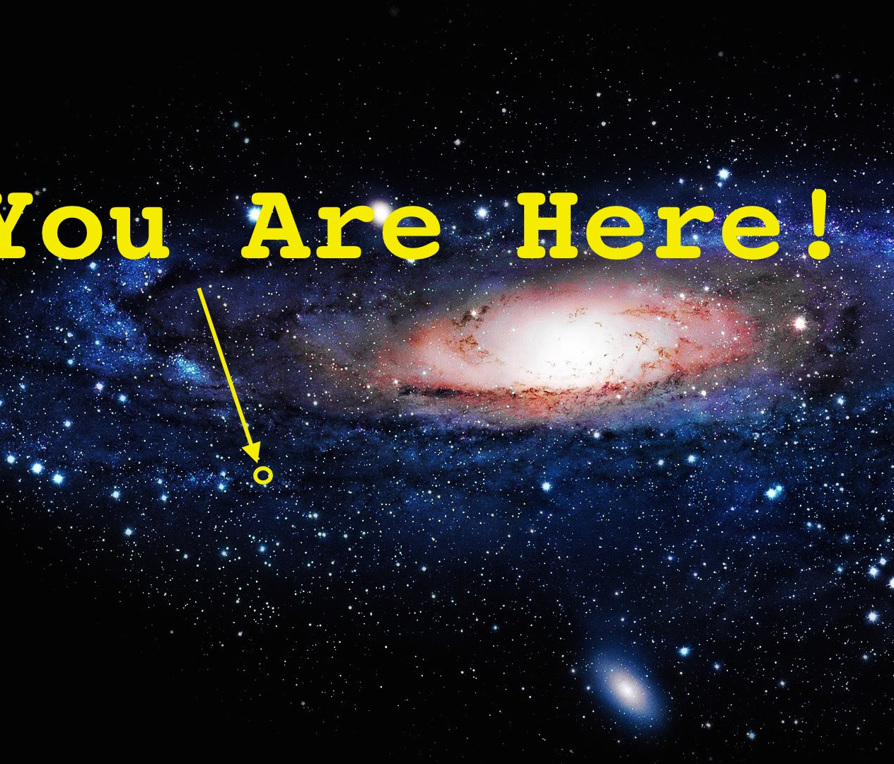
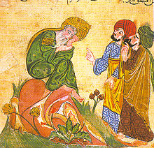
Where next?
Aristotle’s work was mostly destroyed or lost….
But what remained was kept safe in parts of the world soon occupied by Muslims.
During the Abbasid Empire’s reign over the Islamic world translators were asked to find all the knowledge in the Empire – they discovered a lot of Aristotle and began translating it into Arabic.
Those Arabic texts survived and were translated into Latin and then English. Without this chain of events we might not have as much of Aristotle’s work.
Next week we’ll look at the ways these three philosophers answered the Big Questions of the universe!
This Photo by Unknown Author is licensed under CC BY-NC-ND
This Photo by Unknown Author is licensed under CC BY-SA

