Slide 1
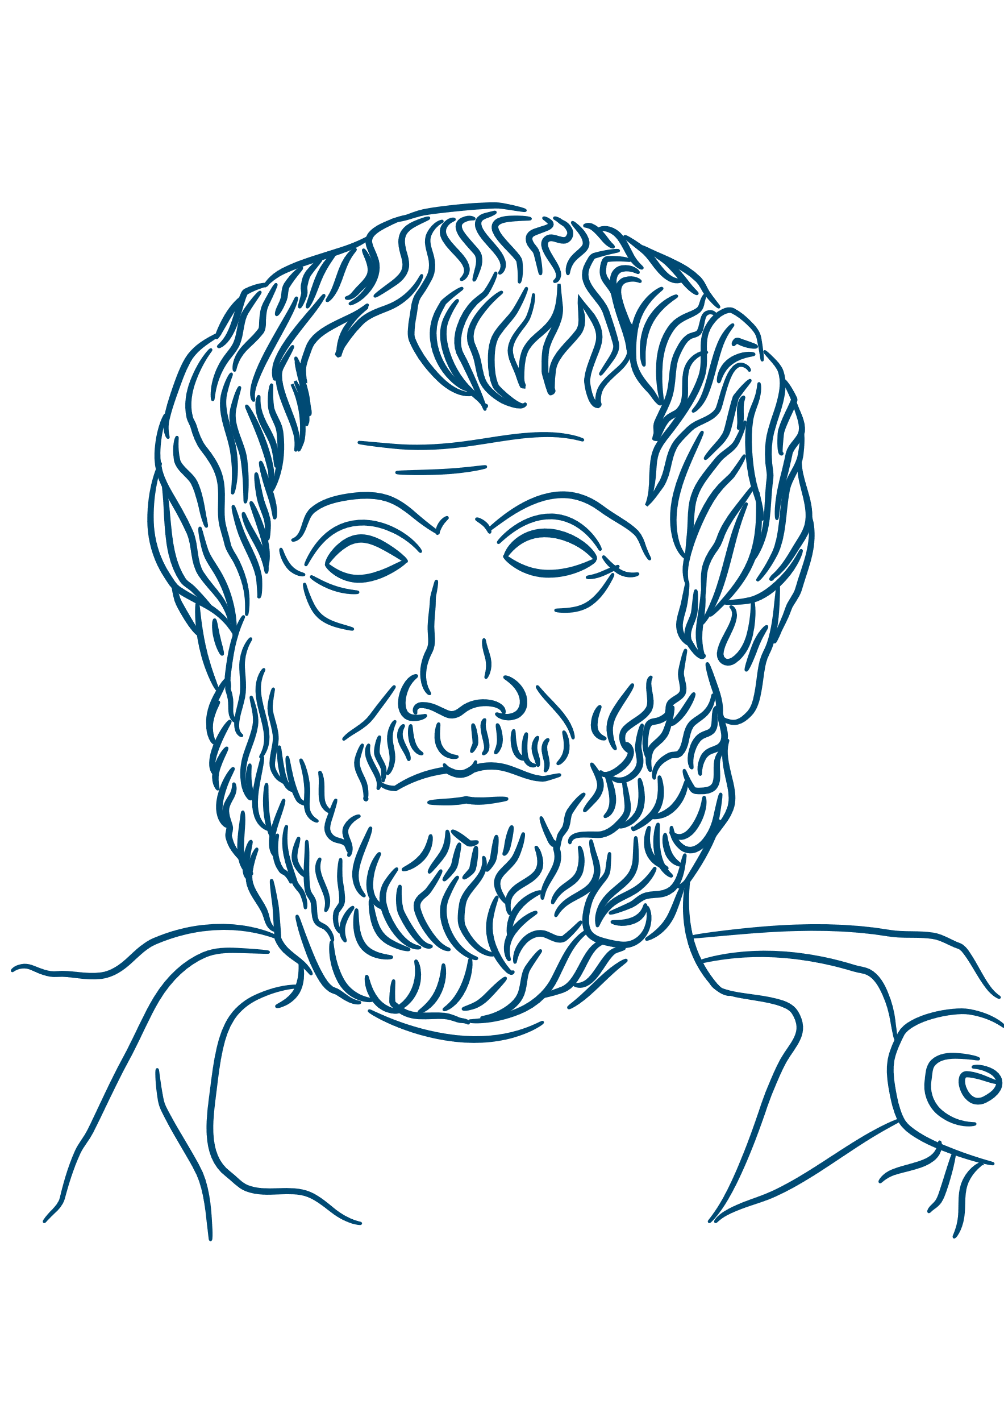
ARISTOTLE
(AH – WRIST – OTTLE)

Slide 2
WHY ARISTOTLE?
Aristotle used logic, a careful way of thinking.
Aristotle pulled everything apart, categorised it and studied it.
Aristotle was an immigrant to Athens, in Greece, from a country called Macedonia.
Aristotle wrote A LOT about all sorts of things – including how to write!
Aristotle invented BIOLOGY!
Notes:
Aristotle bought a logical way of thinking to everything he studied.
He pulled everything apart, categorized it and studied it properly.
He was an immigrant to Athens (from Macedonia) and had to leave Athens twice.
He wrote about literature (how to write and read), ethics (how to live), physics (how the universe works) and in order to study animals and how the natural world worked he had to INVENT BIOLOGY!
Almost all of his work is used in all of these fields of study.

Slide 3
AUTHOR
TEACHER
WHO WAS
SOCRATES?
PHILOSOPHER
LYCEUM
Notes:
Aristotle was born in 384BCE in Stagira (now Macedonia)
He taught many people – most famously Alexander the Great.
He was taught by Plato and hoped to one day inherit the Academy from him. Plato died leaving the Academy to his nephew and Aristotle left Greece in shame.
He opened his own school called the Lyceum (which is what the French call their upper secondary schools - lycée)
He wrote so much but only a few of his works survive and a lot of his lecture notes.

Slide 4
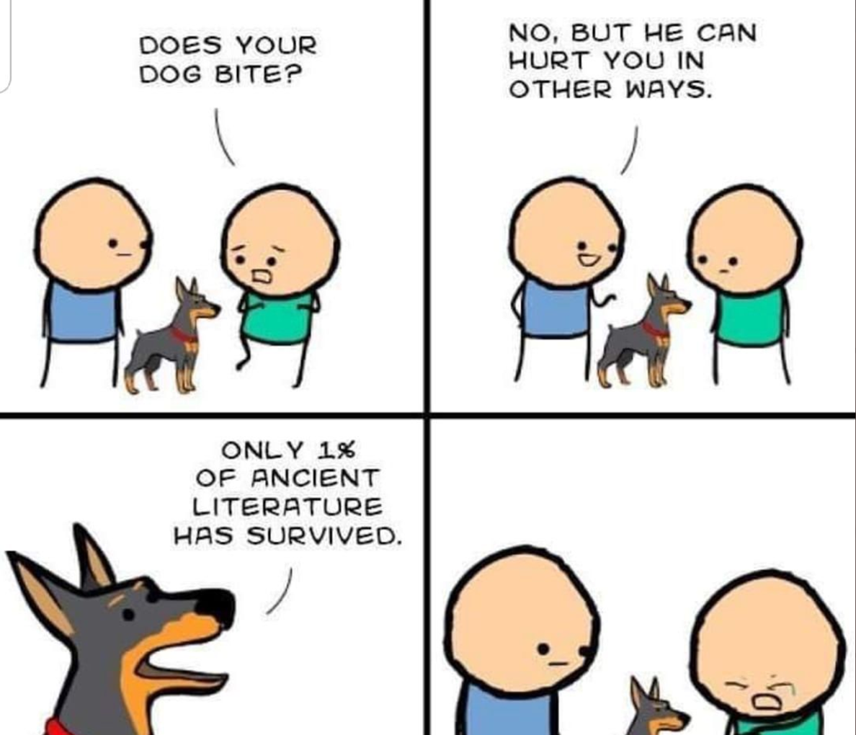

Slide 5
WHAT DID HE DO?
POETICS
Aristotle wrote the Poetics, which are still used today.
PHYSICS
Aristotle wrote the Physics, which explored the cosmos and everything in it.
NICOMACHEAN ETHICS
Aristotle wrote the Nicomachean Ethics, which people still use to learn how to live a good life.
Notes:
Aristotle – wrote the Poetics – this is still used today by Hollywood scriptwriters, Wrote the Physics – this was the basis for all understanding about the Cosmos, Wrote the Nicomachean (nick-oh-mack-ian) Ethics – people still study this to workout how to live a good life. INVENTED BIOLOGY!

Slide 6
ZOOLOGY
LITERATURE
Notes:
We are going to look at two major ideas that we have from Aristotle: zoology or categorising animals and literature.

Slide 7
ZOOLOGY
Aristotle looked closely at animals and wrote about them in detail
He was find out from others about the habits of animals he had never seen – this lead him to get a lot of things totally wrong!
He would dissect animals in order to find out how they worked.
Notes:
Zoology – Aristotle looked closely at animals and wrote about them in detail.
He would dissect animals in order to find out how they worked.
He was find out from others about the habits of animals he had never seen – this lead him to get a lot of things totally wrong!

Slide 8
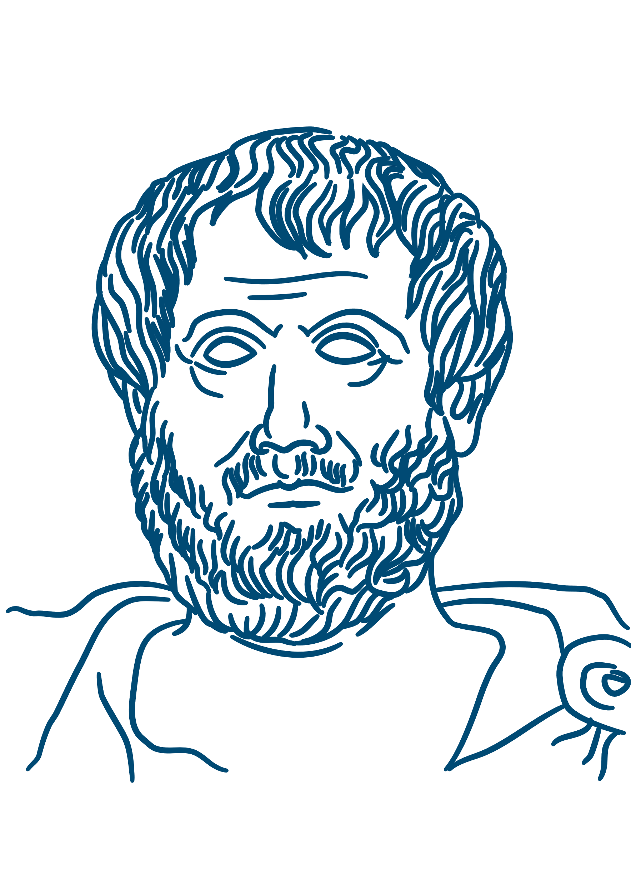
The dolphin…[in air]…has a voice (and can therefore utter vocal or vowel sounds), for it is furnished with a lung and a windpipe; but its tongue is not loose, nor has it lips, so as to give utterance to an articulate sound (or a sound of vowel and constant in combination).
Notes:
Here, Aristotle makes sense of how dolphins can communicate.

Slide 9
ZOOLOGY (CONT)
Aristotle talks about genetic problems passing from one animal to its babies.
Notes:
Here Aristotle talks about genetic problems passing from one animal to it’s babies.
This is amazingly ahead of it’s time!

Slide 10
Just as it sometimes happens that deformed offspring are produced by deformed parents, and sometimes not, so the offspring produced by a female are sometimes female, sometimes not, but male, because the female is as it were a deformed male.
Notes:
He then ruins it by saying that Females are deformed Males! Doh!

Slide 11
In all things of nature there is something of the marvelous.
Notes:
On studying nature.

Slide 12
LITERATURE
Aristotle studied stories and plays
Catharsis
…
sharing in how characters feel
Notes:
Aristotle was the first to study good stories and plays and dissected them like he did his animals.
He pulled them apart to see what they were made of.
He is where we get our plot mountain from and the most basic of story structures….
<click> Catharsis is the idea of sympathising with characters and feeling their emotions – then crying or laughing or feeling scared to get rid of the excess emotions you might have.
So if you’re feeling very sad watch a sad film, have a cry and let it all out!
Or if you’re feeling sorry for yourself watch a film about someone worse off – pour your pity on that character.

Slide 13
A tragedy, then, is the imitation of an action that is serious and also, as having magnitude, complete in itself; in language…not in a narrative form; with incidents arousing pity and fear, wherewith to accomplish its catharsis of such emotions.
Notes:
On tragedy and catharsis.

Slide 14
Honour truth above our friends.
Notes:
Over to you…What do you think these quotes mean?

Slide 15
It is simplicity that makes the uneducated more effective than the educated when addressing popular audiences.
Notes:
Over to you…What do you think these quotes mean?

Slide 16
Man, when perfected, is the best of animals, but when separated from law and justice, he is the worst of all.
Notes:
Over to you…What do you think these quotes mean?

Slide 17
Man, when perfected, is the best of animals, but when separated from law and justice, he is the worst of all.
Notes:
Over to you…What do you think these quotes mean?

Slide 18
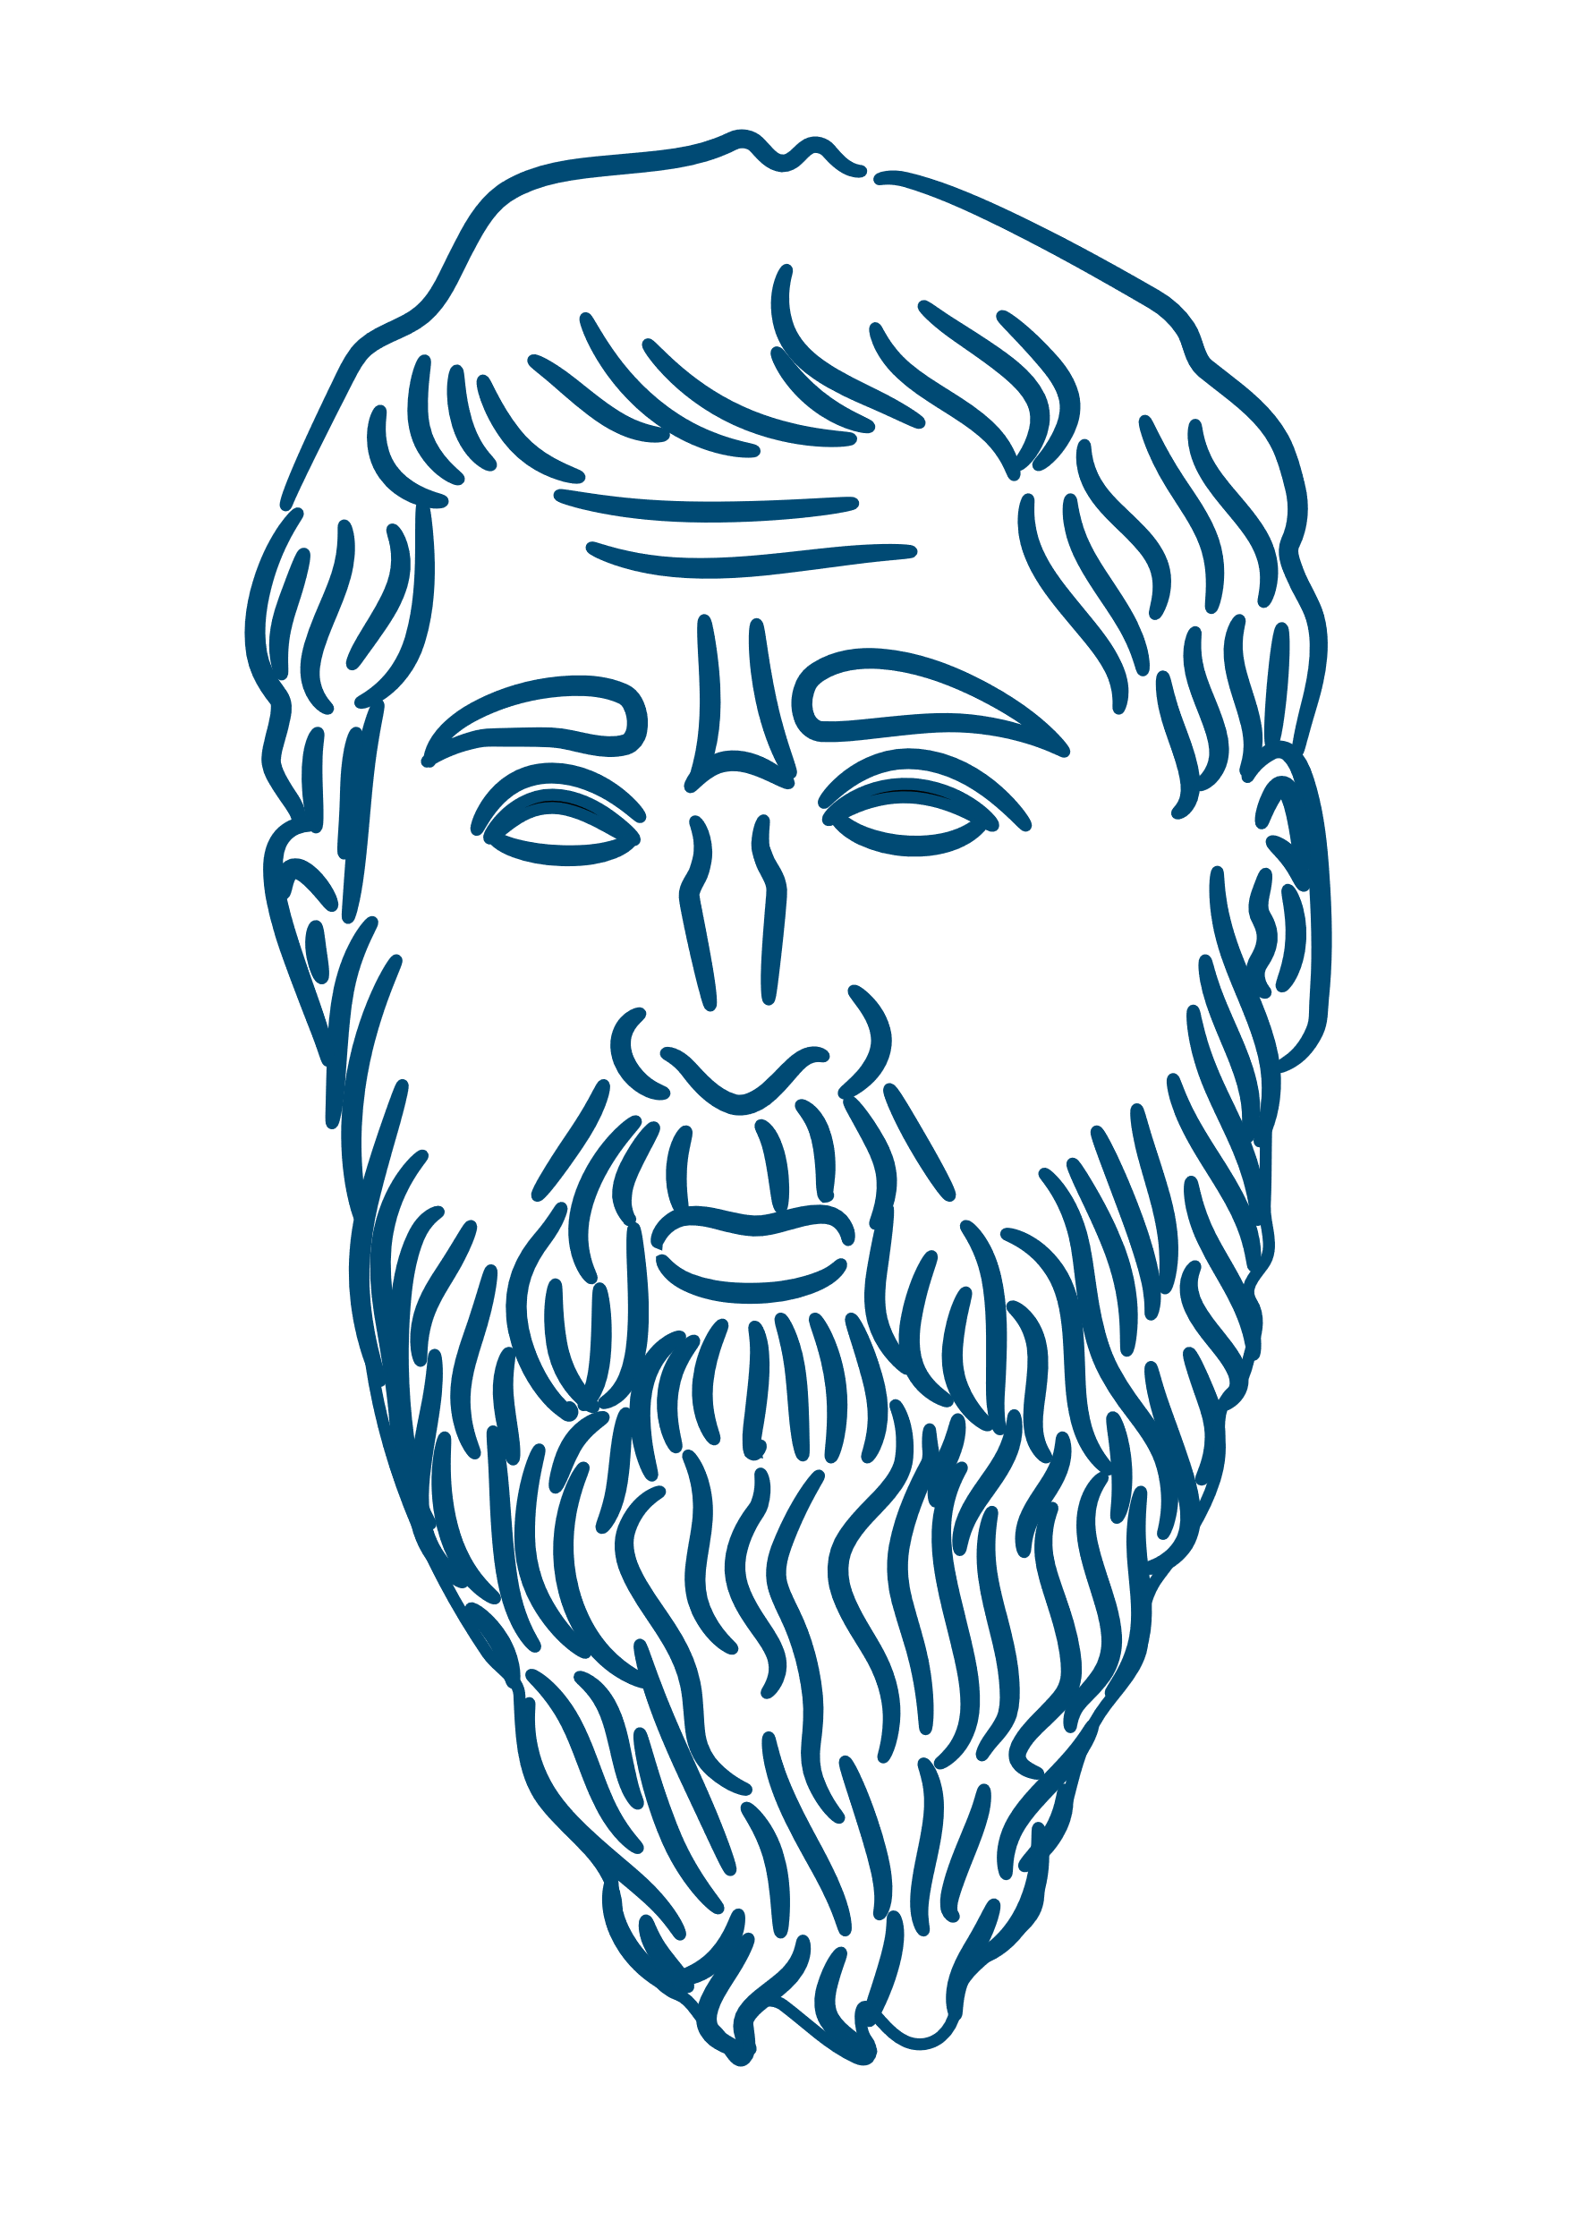
World of Forms
World of Matter
World of Forms
Ideal Form
Things
Things
World of Matter
Plato
Aristotle
Notes:
When Aristotle left Plato’s school it resulted in him finding a totally different way of seeing the world.
Edith Hall – Classics professor at Kings College London believes that Plato had terrible eyesight, so when he saw things he thought about the perfect version, in his head…He then reasoned that this perfect version comes from the Realm of the Forms (a heavenly eternal place)
<click> Hall goes on say that she believes that Aristotle’s vision was perfect and so he looks at the world for what it really is…

Slide 19
Notes:
Aristotle’s work was mostly destroyed or lost….
But what remained was kept safe in parts of the world soon occupied by Muslims.
During the Abbasid Empire’s reign over the Islamic world translators were asked to find all the knowledge in the Empire – they discovered a lot of Aristotle and began translating it into Arabic.
Those Arabic texts survived and were translated into Latin and then English. Without this chain of events we might not have as much of Aristotle’s work.
Next week we’ll look at the ways these three philosophers answered the Big Questions of the universe!

Slide 20
End of slide show
Notes:
Well, that’s the thing, he never wrote anything down so we don’t know much about him.
<click> Next week we will talk about Plato – who used Socrates as a character in his books.
But until then – Please take a look at the form and complete some of the questions on there.

Slide 21
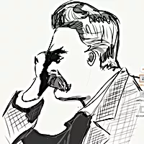
Author
For resources, lessons and more, visit https://www.philosophyinks2.co.uk
Mr Semmens
Design
Mr Stevenson

