Slide 1
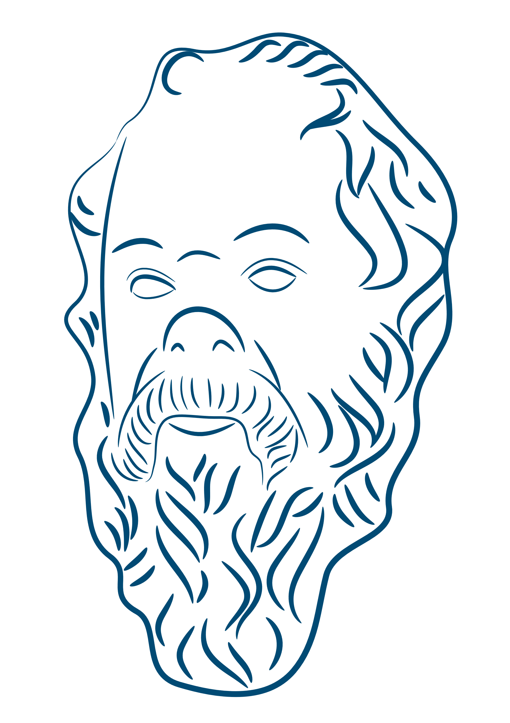
SOCRATES
(SOCK – RAT – EES)

Slide 2
WHY SOCRATES?
Socrates was born in 470BC and died in 399Bc. He lived for 71 years.
Socrates is THE philosopher, for many people.
In philosophy books, everyone teaching before Socrates is called
pre-Socratic.
Before Socrates there were lots of philosophers - too many to count!
One philosopher before Socrates was a man called Pythagoras. You will learn about his ideas in maths.
Notes:
Socrates is, for many people, THE philosopher.
If you study philosophy at University or read a philosophy book everyone before Socrates is called a Pre-Socratic.
Before Socrates the world still had philosophers but there are too many to count.
One in particular that you will all learn about in high school was a guy called Pythagoras.
Anyway, Socrates was born in 470bc and died in 399bc (he lived for 71 years)

Slide 3
SOLDIER
PHILOSOPHER
WHO WAS
SOCRATES?
WISEST MAN
Socrates famously did not get on well with his wife!
Socrates was said to have amazing abilities, like staying in the snow all night in his summer clothes!
IMMORTAL SOUL
Notes:
He was a soldier
He was a philosopher
He was also called the ‘wisest man in Athens’ by the Oracle at Delphi. This meant that lots of people asked him all sorts of questions about life…which got him thinking.
He believed in the soul – the spirit that lives in our bodies and leaves to go to heaven when we die (this is a very Christian idea)
<click> He was said to have immense abilities like staying out all night in the snow with only summer clothes on and not feeling a thing!
<click> He famously didn’t like his own wife!

Slide 4
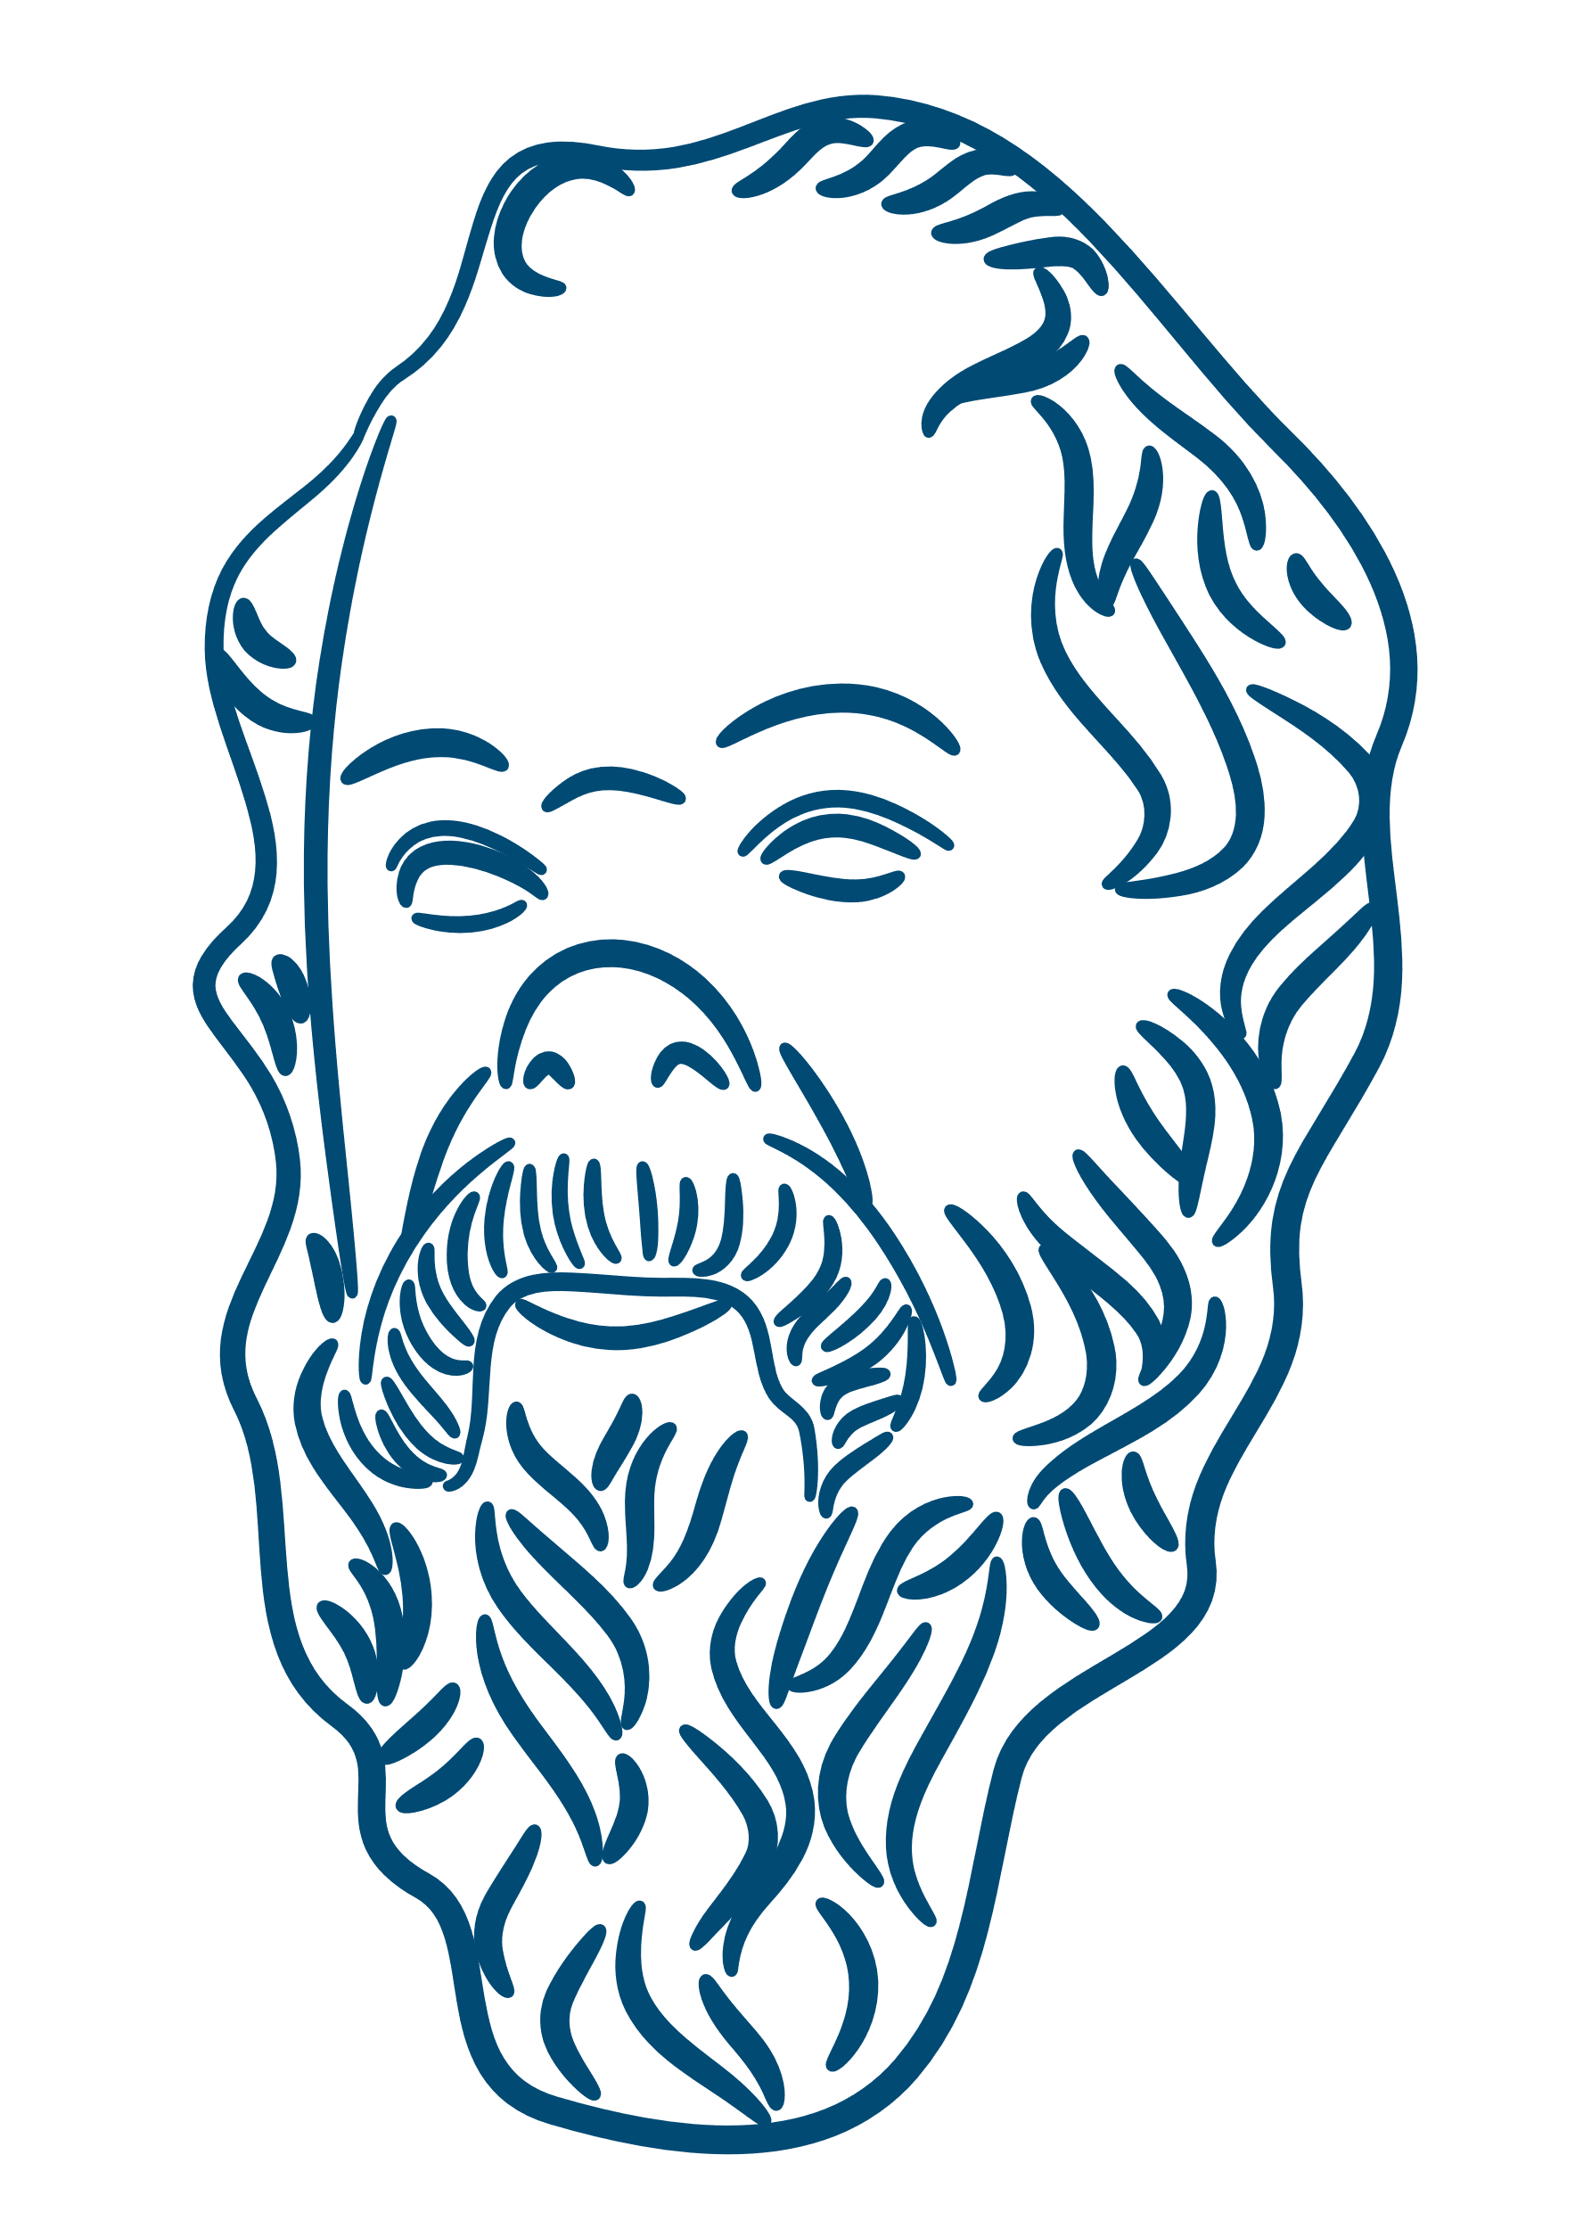
The only true knowledge is knowing you know nothing.
Socrates was famous for destroying other people’s beliefs.
Socrates was nicknamed “Torpedo” because he stunned people into silence.
Notes:
Why was he famous?
<click> Socrates was famous for destroying other people’s beliefs.
<click> He was nicknamed the Torpedo because he used to stun people into silence so that they couldn’t argue any longer.

Slide 5
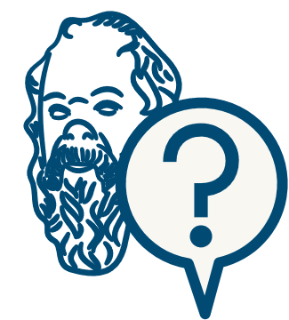
WHAT DID HE DO?
Sophists were clever and often lied.
Socrates didn’t like sophists because they helped bad people.
Socrates asked people questions in the town square.
We call this the Socratic Method.
Notes:
In Socrates’ time Greece was full of people called ‘Sophists’, they were kind of like the lawyers and politicians of today.
Socrates hated them because he saw criminals going free because they had the best lawyers and bad politicians winning votes because they were good at arguing.
Sound familiar?
So Socrates went out into the Agora (the public square) and talked to people, asking them questions.
He is credited with creating the Socratic Method.

Slide 6
THE SOCRATIC METHOD
hypothesis giving a reason for something so we can start learning about it
1
2
3
4
5
ASK A QUESTION
“Why do things fall when we drop them?”
FORM A HYPOTHESIS
Things fall because something in the air pushes them.
TEST THE HYPOTHESIS
What about under water? Things sink under water, but there’s no air.
ACCEPT OR REJECT
Our test shows things fall downwards, even without air, so maybe it works differently?
ACT ACCORDINGLY
Something else must make things fall down – I should go away and think about it!
Notes:
1. Ask a question - Why do things fall when we drop them?
2. Form a hypothesis – Things drop to the ground because there is something in the air pushing them down.
3. Test the hypothesis – What about under water? Things still sink to the bottom when there’s no air.
4. Accept/reject according to testing – So if things fall to earth, or down, even when there’s no air around then perhaps it doesn’t work that way.
5. Act accordingly – There must be some other force that pulls things down instead – I will think about this.

Slide 7
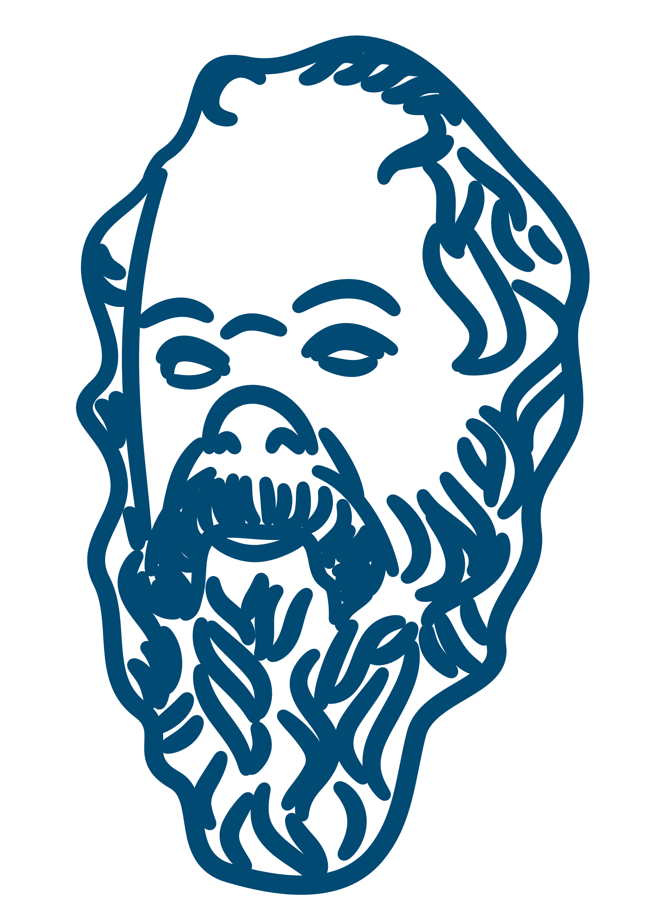
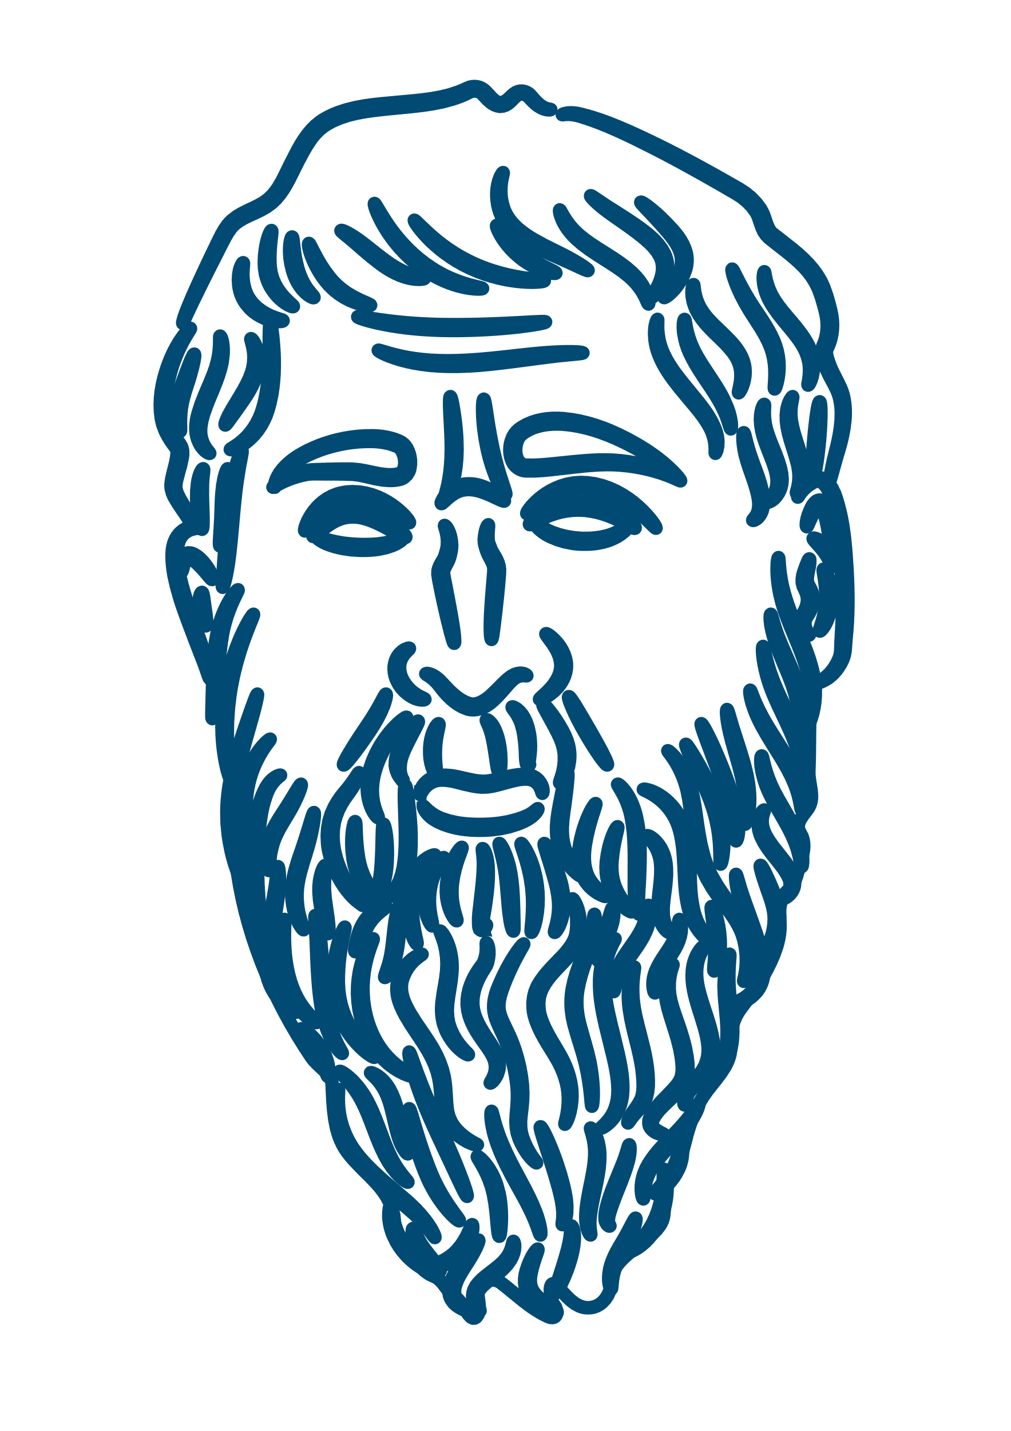
IS HE STILL IMPORTANT?
New way to understand.
He was executed
Made philosophy cool!
Inspired Plato
Notes:
Socrates invented a way of understanding things and rooting out nonsense.
He made philosophy seriously cool – he was a very famous guy at the time.
He was executed (I’ll tell you about that in a minute) and because of that he made sure that people were dedicated to his legacy.
He left behind some very important people – including Plato (next week’s Philosopher).
He became a character in Plato’s work and so became quite a famous literary figure.

Slide 8
To move the world, we must first move ourselves.
Notes:
Here are some of Socrates’ most famous quotes…though there are many more!

Slide 9
Wonder is the beginning of wisdom.
Notes:
Here are some of Socrates’ most famous quotes…though there are many more!

Slide 10
Education is the kindling of a flame, not the filling of a vessel.
Notes:
Here are some of Socrates’ most famous quotes…though there are many more!

Slide 11
I know that I am intelligent, because I know that I know nothing.
Notes:
Here are some of Socrates’ most famous quotes…though there are many more!

Slide 12
True wisdom comes to each of us when we realise how little we understand about life, ourselves, and the world around us.
Notes:
Here are some of Socrates’ most famous quotes…though there are many more!

Slide 13
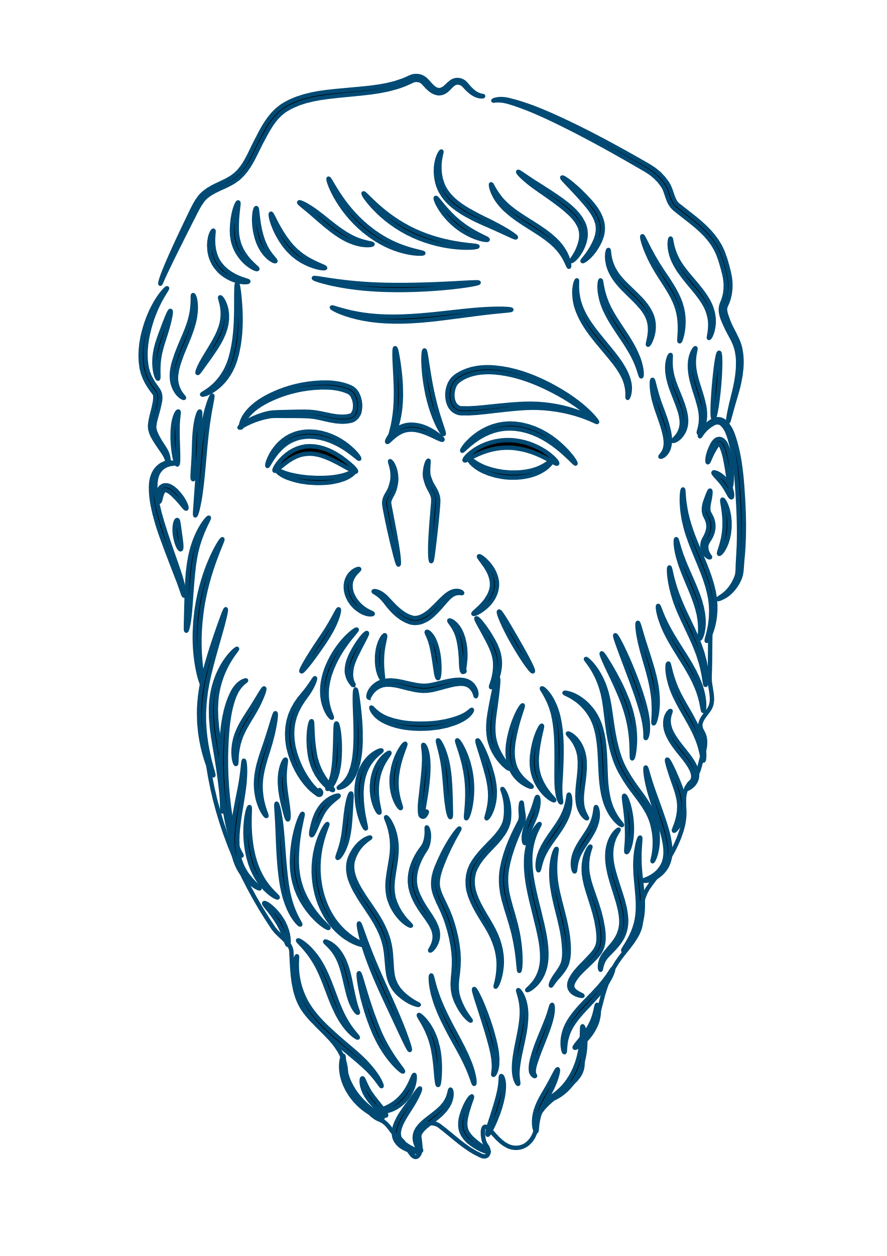
WHAT ELSE DID HE SAY?
Notes:
Well, that’s the thing, he never wrote anything down so we don’t know much about him.
<click> Next week we will talk about Plato – who used Socrates as a character in his books.
But until then – Please take a look at the form and complete some of the questions on there.

Slide 14
End of slide show
Notes:
Well, that’s the thing, he never wrote anything down so we don’t know much about him.
<click> Next week we will talk about Plato – who used Socrates as a character in his books.
But until then – Please take a look at the form and complete some of the questions on there.

Slide 15
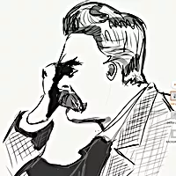
Author
For resources, lessons and more, visit https://www.philosophyinks2.co.uk
Mr Semmens
Design
Mr Stevenson

