Slide 1
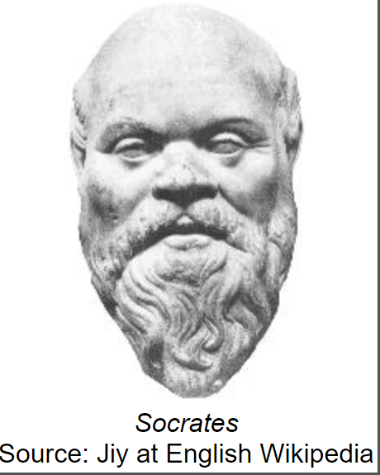
Socrates
What can we learn from The Great Philosophers?

Slide 2
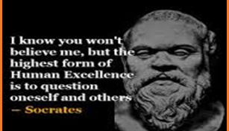
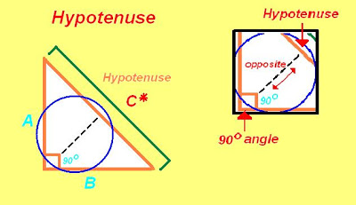
Why Socrates?
Socrates is, for many people, THE philosopher.
If you study philosophy at University or read a philosophy book everyone before Socrates is called a Pre-Socratic.
Before Socrates the world still had philosophers but there are too many to count.
One in particular that you will all learn about in high school was a guy called Pythagoras.
Anyway, Socrates was born in 470bc and died in 399bc (he lived for 71 years)
This Photo by Unknown Author is licensed under CC BY-NC-ND
This Photo by Unknown Author is licensed under CC BY-SA-NC

Slide 3
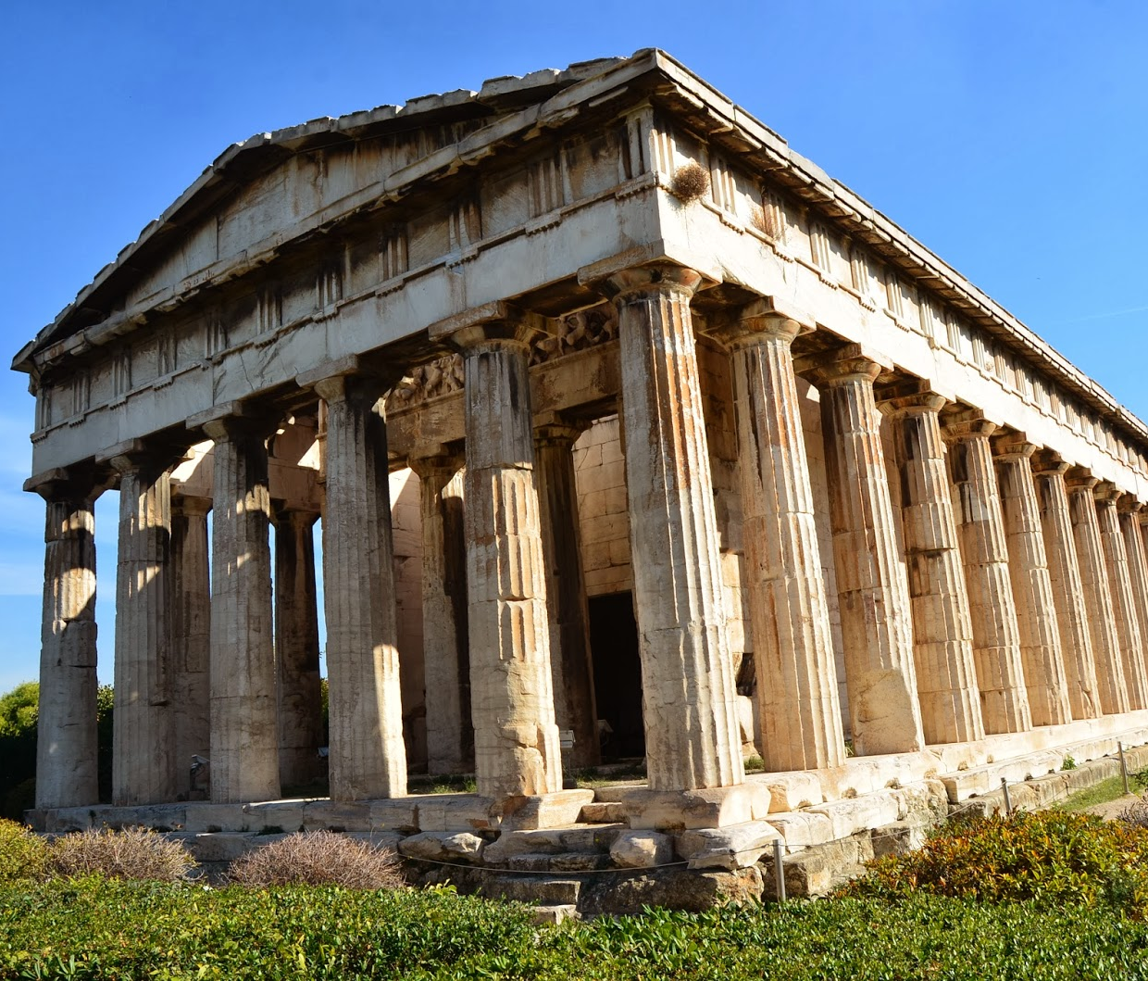
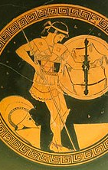
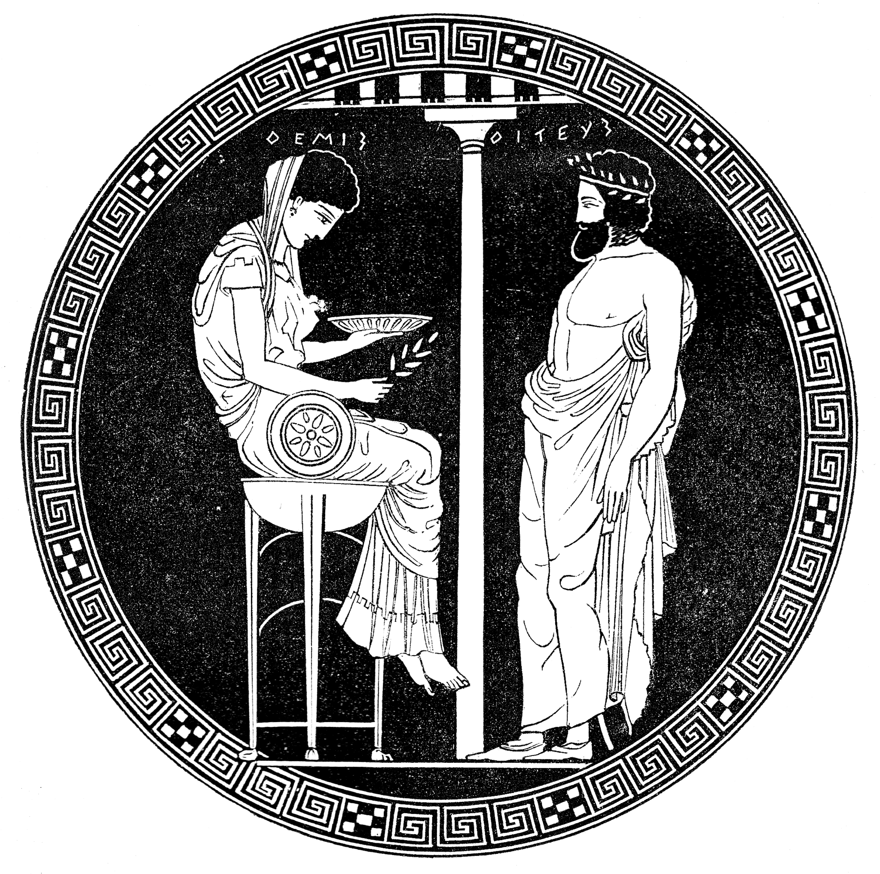
Who? When?
He was a soldier
He was a philosopher
He famously didn’t like his own wife!
He was said to have immense abilities like staying out all night in the snow with only summer clothes on and not feeling a thing!
He was also called the ‘wisest man in Athens’ by the Oracle at Delphi. This meant that lots of people asked him all sorts of questions about life…which got him thinking.
He believed in the soul – the spirit that lives in our bodies and leaves to go to heaven when we die (this is a very Christian idea)
This Photo by Unknown Author is licensed under CC BY-NC
This Photo by Unknown Author is licensed under CC BY-NC-ND
This Photo by Unknown Author is licensed under CC BY-SA

Slide 4
Why was he famous?
Socrates was famous for destroying other people’s beliefs.
He was nicknamed the Torpedo because he used to stun people into silence so that they couldn’t argue any longer.
He is famous for saying:
The only true knowledge is knowing you know nothing.

Slide 5
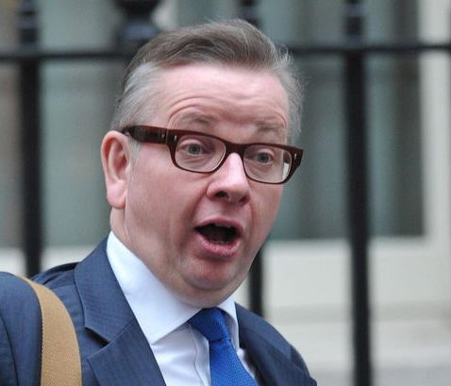
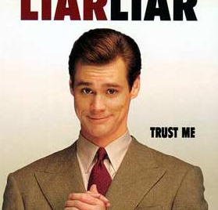
Why did he do it?
In Socrates’ time Greece was full of people called ‘Sophists’, they were kind of like the lawyers and politicians of today.
Socrates hated them because he saw criminals going free because they had the best lawyers and bad politicians winning votes because they were good at arguing.
Sound familiar?
So Socrates went out into the Agora (the public square) and talked to people, asking them questions.
He is credited with creating the Socratic Method.
This Photo by Unknown Author is licensed under CC BY-SA
This Photo by Unknown Author is licensed under CC BY

Slide 6
How did he do it? Socratic Method – this one is on wrong ideas about gravity
1. Ask a question - Why do things fall when we drop them?
2. Form a hypothesis – Things drop to the ground because there is something in the air pushing them down.
3. Test the hypothesis – What about under water? Things still sink to the bottom when there’s no air.
4. Accept/reject according to testing – So if things fall to earth, or down, even when there’s no air around then perhaps it doesn’t work that way.
5. Act accordingly – There must be some other force that pulls things down instead – I will think about this.

Slide 7
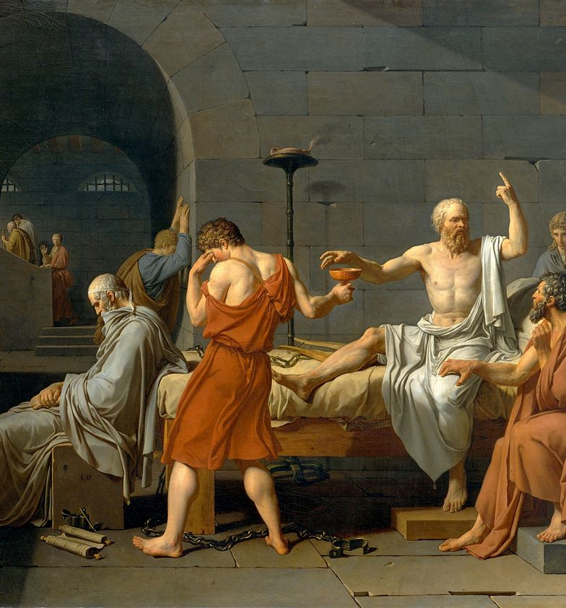
What is his legacy? (Why is he still important?)
Socrates invented a way of understanding things and rooting out nonsense.
He made philosophy seriously cool – he was a very famous guy at the time.
He was executed (I’ll tell you about that in a minute) and because of that he made sure that people were dedicated to his legacy.
He left behind some very important people – including Plato (next week’s Philosopher).
He became a character in Plato’s work and so became quite a famous literary figure.
This Photo by Unknown Author is licensed under CC BY-SA-NC

Slide 8
This Photo by Unknown Author is licensed under CC BY

Slide 9
He was big on education of the young.

Slide 10
This Photo by Unknown Author is licensed under CC BY
This Photo by Unknown Author is licensed under CC BY
This Photo by Unknown Author is licensed under CC BY-SA

Slide 11
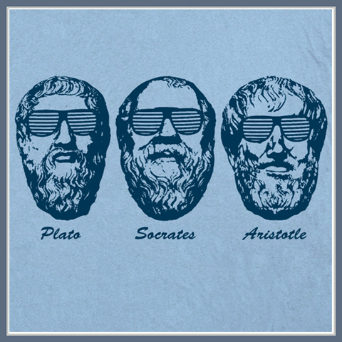
What other ideas did Socrates have?
Well, that’s the thing, he never wrote anything down so we don’t know much about him.
Next week we will talk about Plato – who used Socrates as a character in his books.
But until then – Please take a look at the form and complete some of the questions on there.
This Photo by Unknown Author is licensed under CC BY-NC-ND

