Slide 1
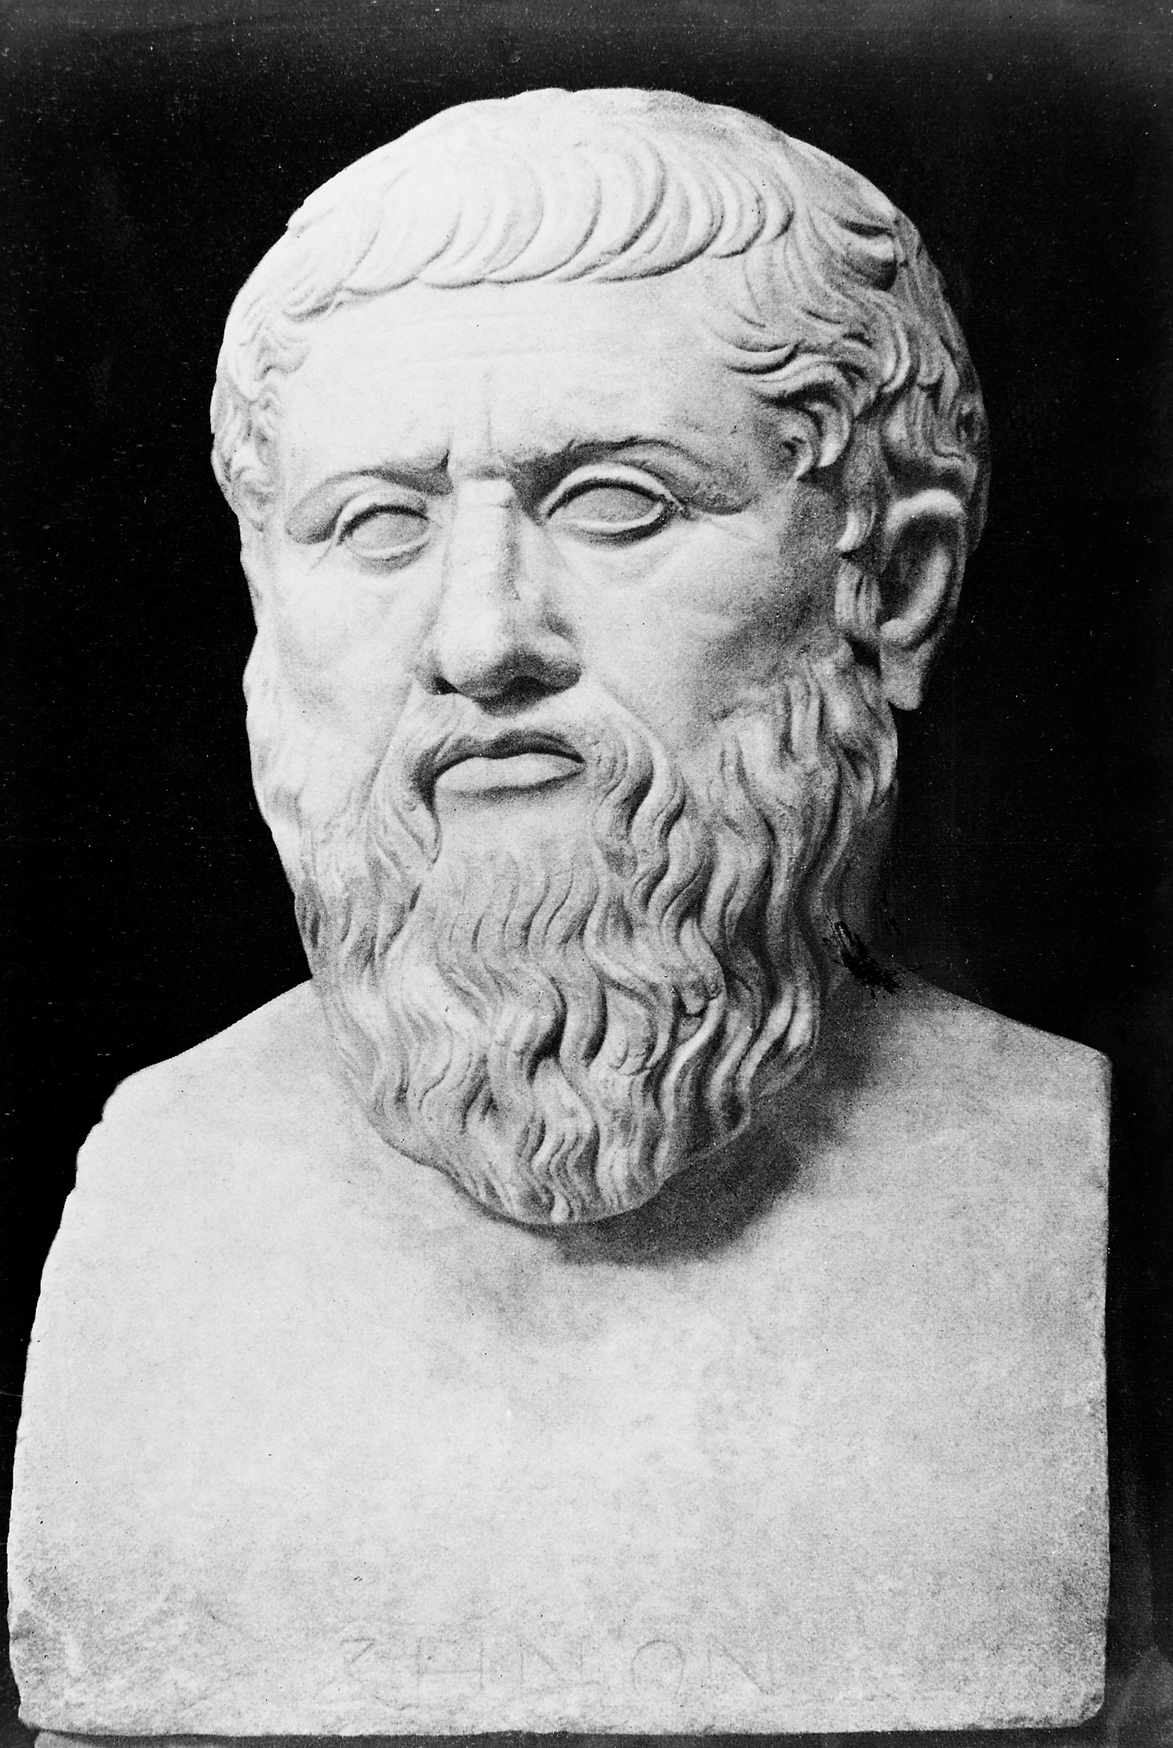
The Great Philosophers: Plato
What can we learn from the Great Philosophers?
This Photo by Unknown Author is licensed under CC BY-SA

Slide 2
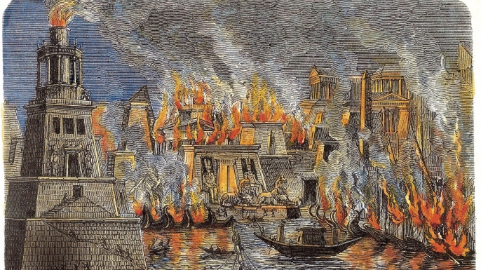
Why Plato?
Plato wrote a lot of books and almost all of them survived (a lot of ancient work has been destroyed by fire, religious zealots and battles)
He wrote well and included ‘funny’ characters in his work.
He came up with a lot of political theory (all the ‘ocracies have been written about in a book called The Republic.
He had some very interesting ideas about where truth comes from.
He made Socrates famous.
He came up with The Allegory of the Cave which you will look at in today.
This Photo by Unknown Author is licensed under CC BY-SA-NC

Slide 3
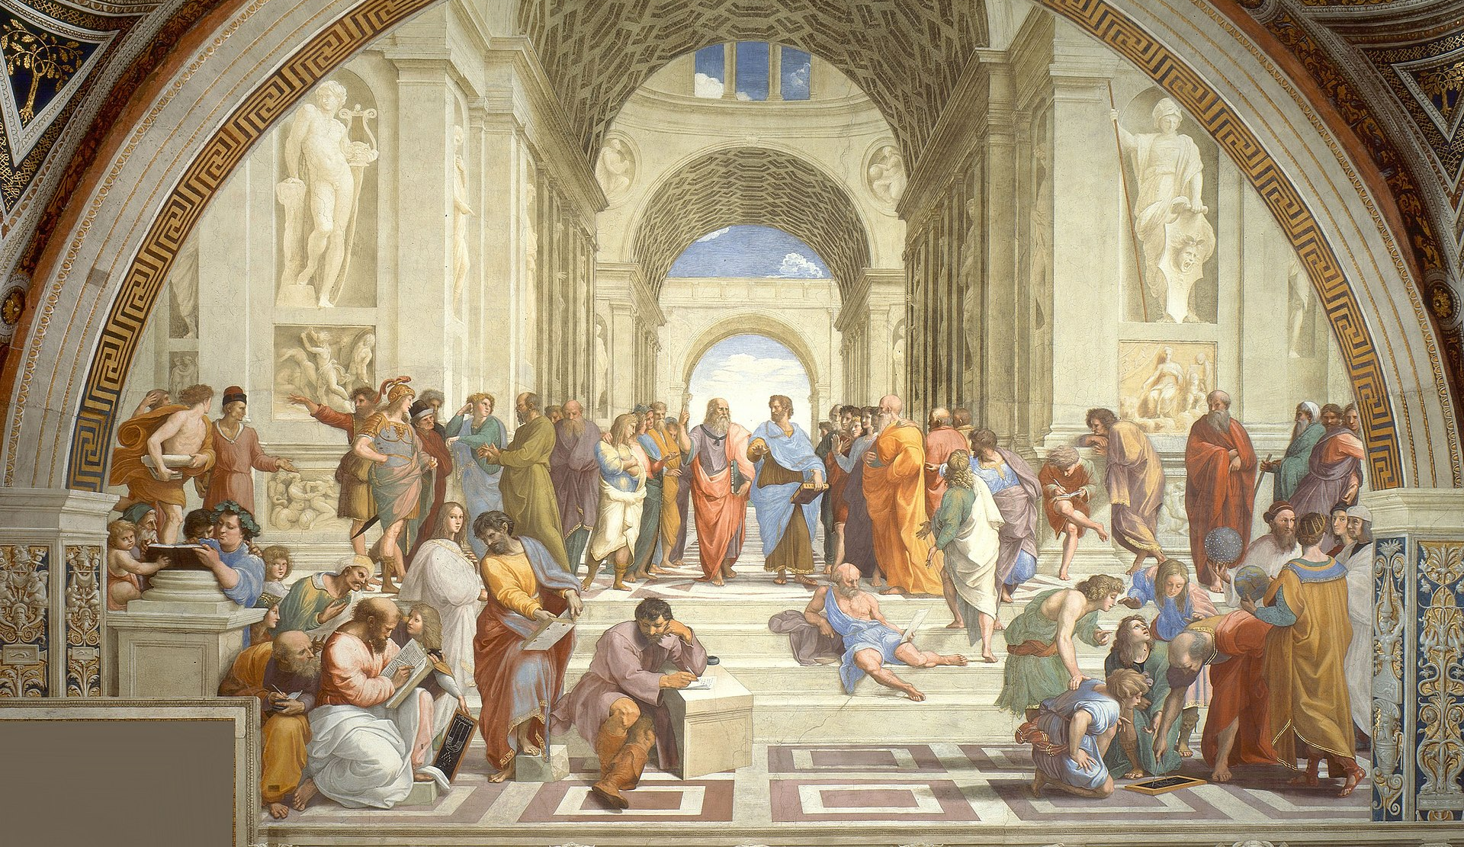
Plato: Who? When
Plato was born in 428BCE and died in 348BCE – he was 80 when he died.
He taught many people including Aristotle (for about 20 years)
He opened a place of learning called ‘The Academy’ which was open on and off for almost 900 years after his death.
He lived in Athens, in Greece.
He wrote extensively.
This Photo by Unknown Author is licensed under CC BY-SA

Slide 4
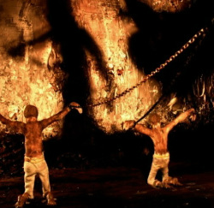
Why was he famous?
The Allegory of the Cave:
https://youtu.be/69F7GhASOdM
Please mute your mic and watch this clip – it is about 3 minutes long…
I will ask you all questions about it in the Chat afterwards.
This Photo by Unknown Author is licensed under CC BY-SA-NC

Slide 5
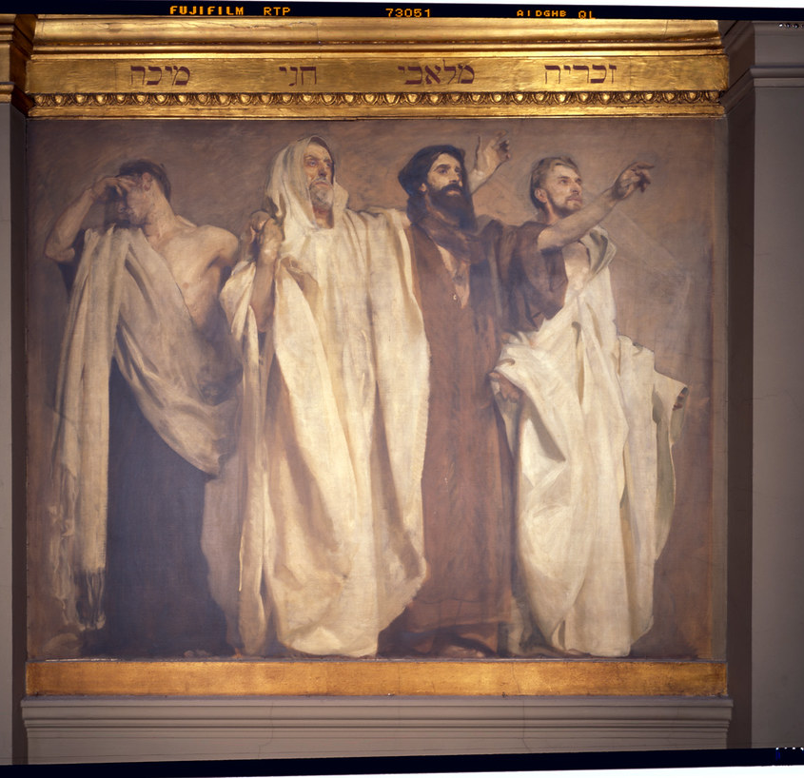
Why did he do it?
Plato thought that the role of the Philosopher was to reveal the truth to people who were otherwise clueless!
In other words the Philosopher knew what other didn’t and it was his job to educate them.
This role of Philosopher is the same for the Prophet (Muhammad, Moses, Elijah, Jesus) and the visionary (John – the Book of Revelations)
Plato believed so much in the value of Philosophy that he said that Philosophers should be Kings!
This Photo by Unknown Author is licensed under CC BY-NC-ND

Slide 6
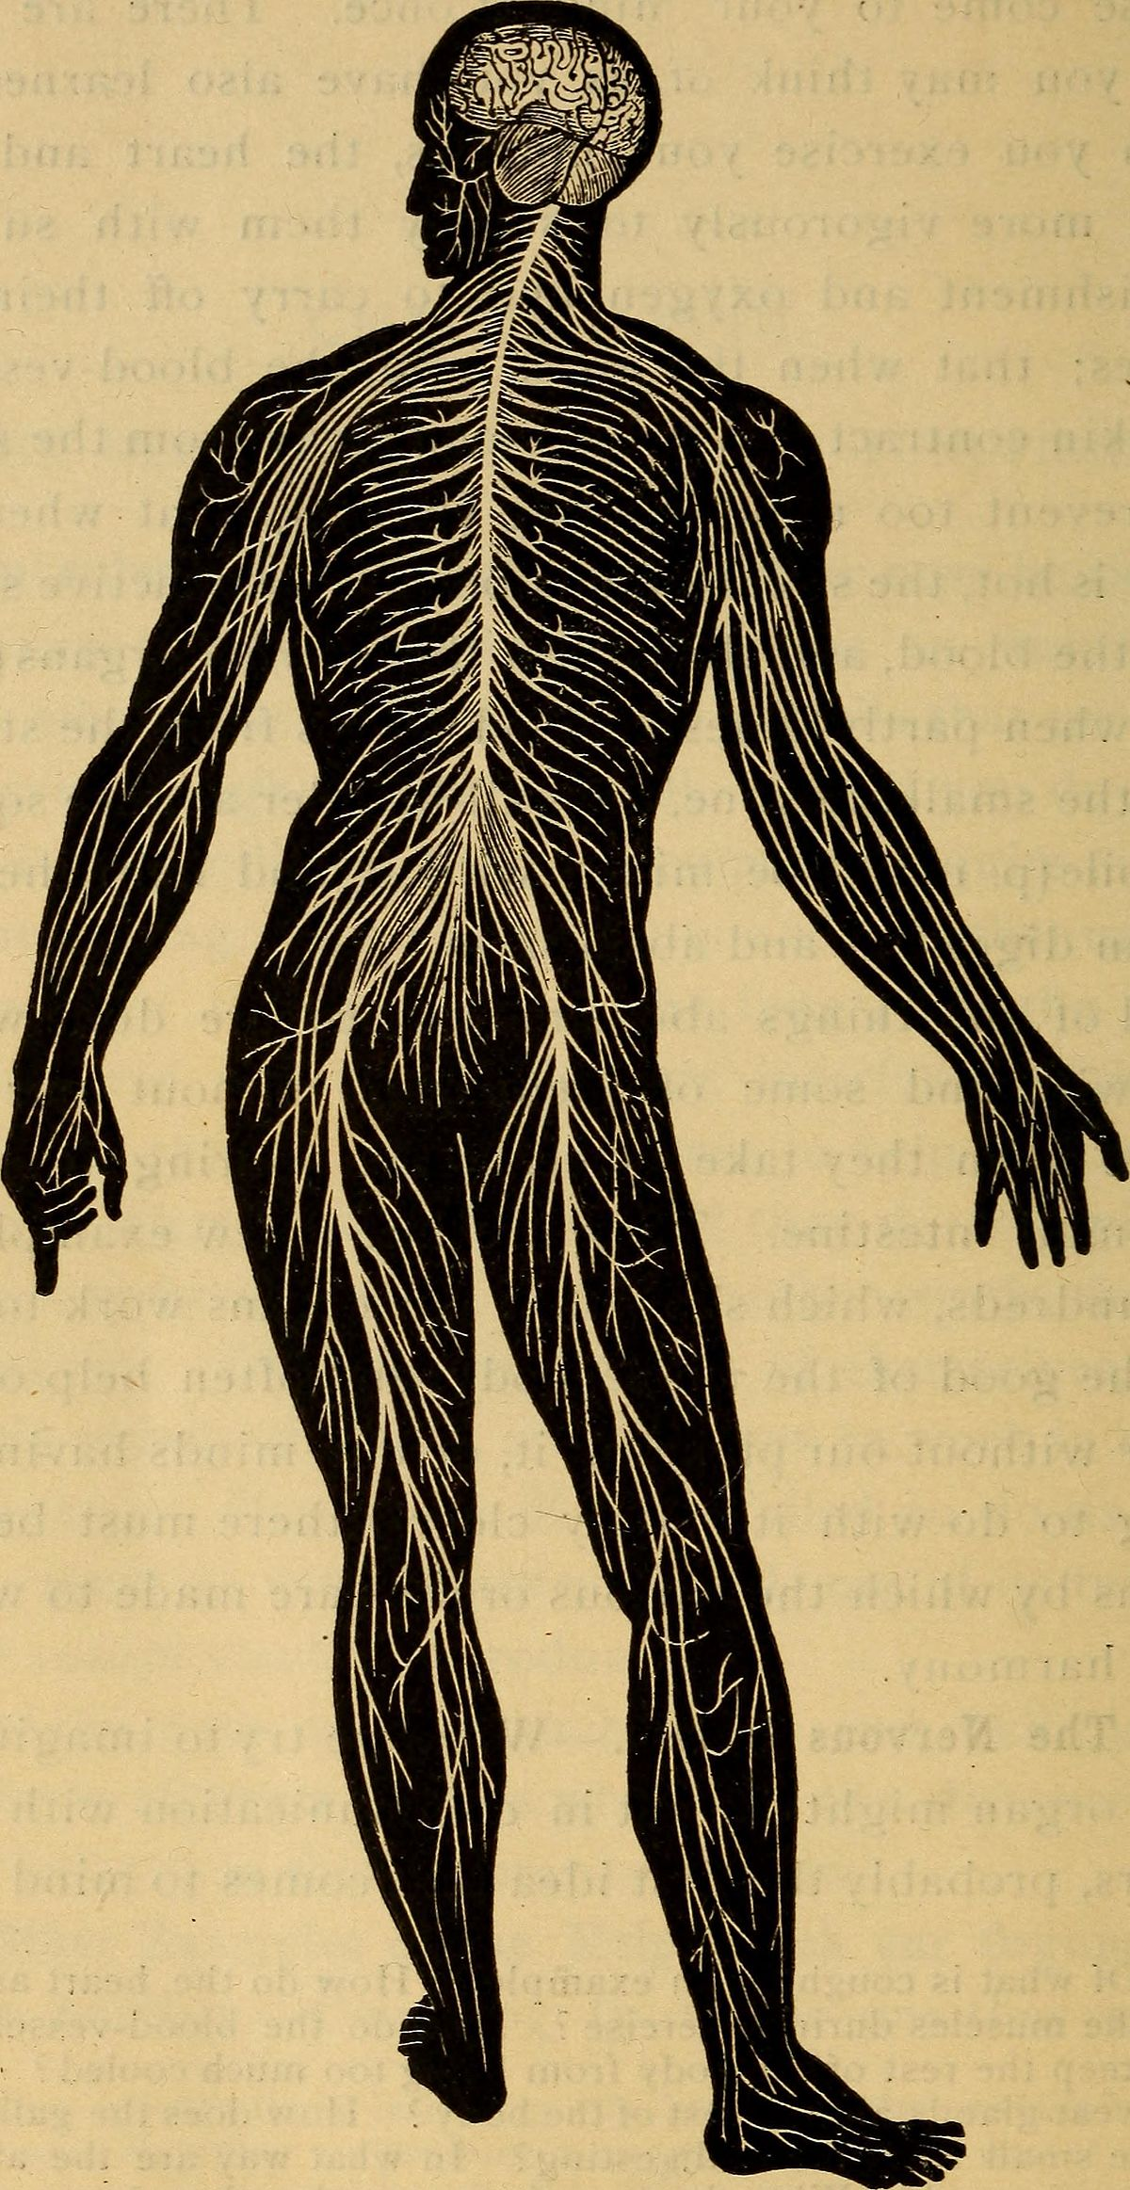
How would this work?
Well, the Philosopher, the cleverest and most educated person in the city would be like the Head and do all the thinking.
He would then rule over the administrators, who would be like the lungs and heart.
They would control the hands and arms (The army and the workers)
Something to bear in mind when thinking about this is that Plato, a philosopher, thinks that Philosophers should be in charge…I wonder who you think should be in charge today?
This Photo by Unknown Author is licensed under CC BY-SA

Slide 7
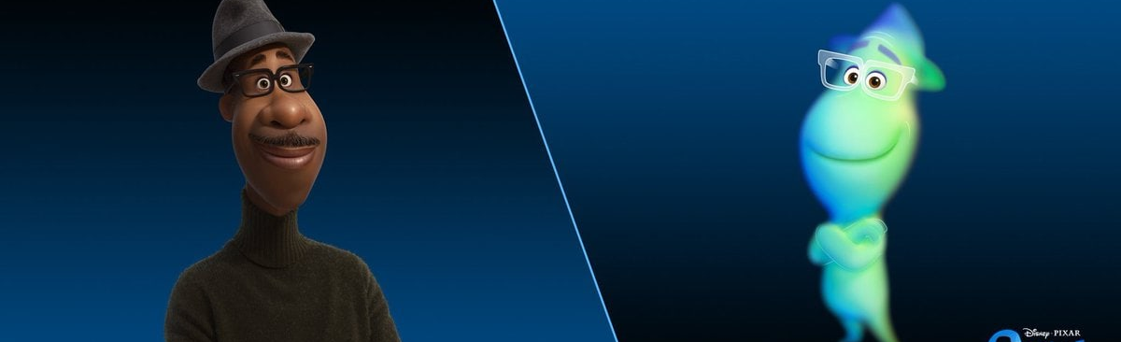
His Legacy – why do we learn about him today?
He talked about the soul, just like Socrates did and said that it was separate to the body.
He went a little further and said that the body would rot, decay and eventually die – like everything else in the world.
So, because of this the world was not to be cared about all that much. It would be here today and gone tomorrow…but your soul is eternal!
The soul was once in heaven and will return there…
The eternal nature of the soul means that it is the only thing worth caring about…but the body sometimes misunderstands it.
This Photo by Unknown Author is licensed under CC BY-NC-ND

Slide 8
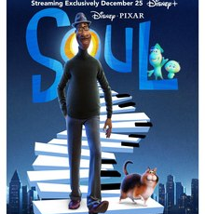
The Soul
This Photo by Unknown Author is licensed under CC BY-SA
This Photo by Unknown Author is licensed under CC BY-NC-ND
This Photo by Unknown Author is licensed under CC BY-SA

Slide 9
The Soul – Eternal knower of all things…
For Plato the heavens were full of the eternal things and the soul was one of those things.
It arrived on earth in your newly born body and knew ALL things….but the body gets in the way.
If you just listen, learn and think then all that knowledge will come back to you…
If you don’t, it won’t!
Some people can learn and some people can’t…

Slide 10
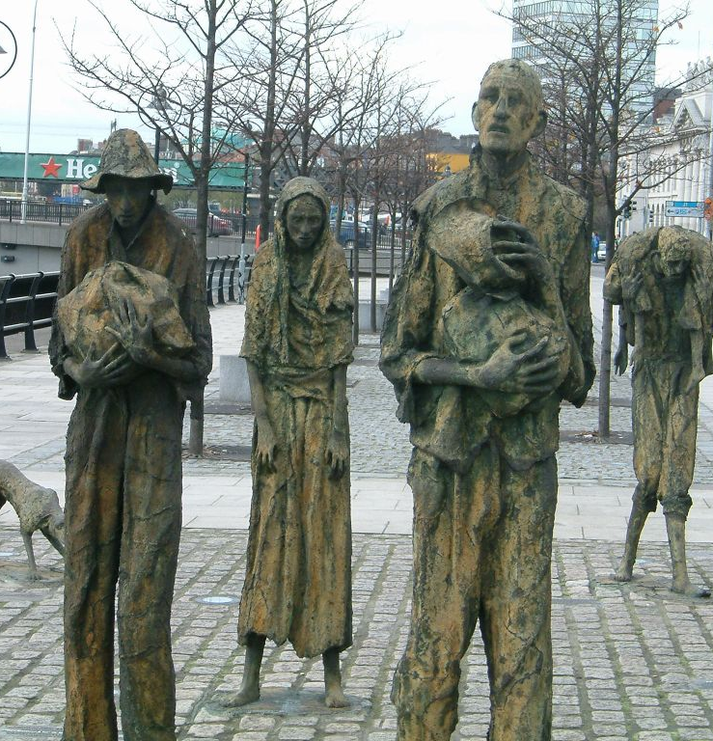
Plato and the world
For Plato and his followers the world was something to live through…
Heaven was somewhere to get back to…
This idea influenced Christians and their ideas about the afterlife….
It also led to a lot of people accepting that this life might be rubbish and they might have a rubbish place in it.
That they should also not worry about this world was a very catchy idea….
It makes it easier to live through all the hard times if you know they don’t matter…
This Photo by Unknown Author is licensed under CC BY-NC-ND

Slide 11
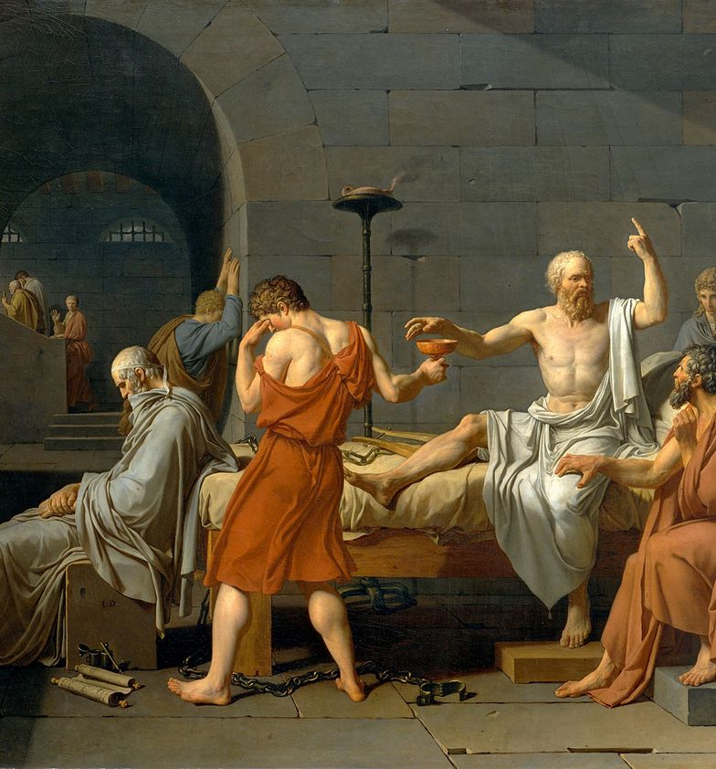
Plato and Aristotle
Plato was the teacher and hoped to take over the Academy.
When Plato died it was left to someone else and so Aristotle packed up and left!
As a result his philosophy could not be more different from Plato’s work. This was great for Science…We’ll look at Aristotle next week.
This Photo by Unknown Author is licensed under CC BY-SA-NC

Slide 12
This Photo by Unknown Author is licensed under CC BY-NC-ND

Slide 13
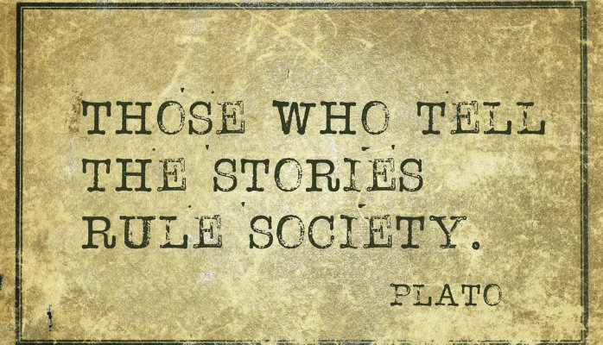
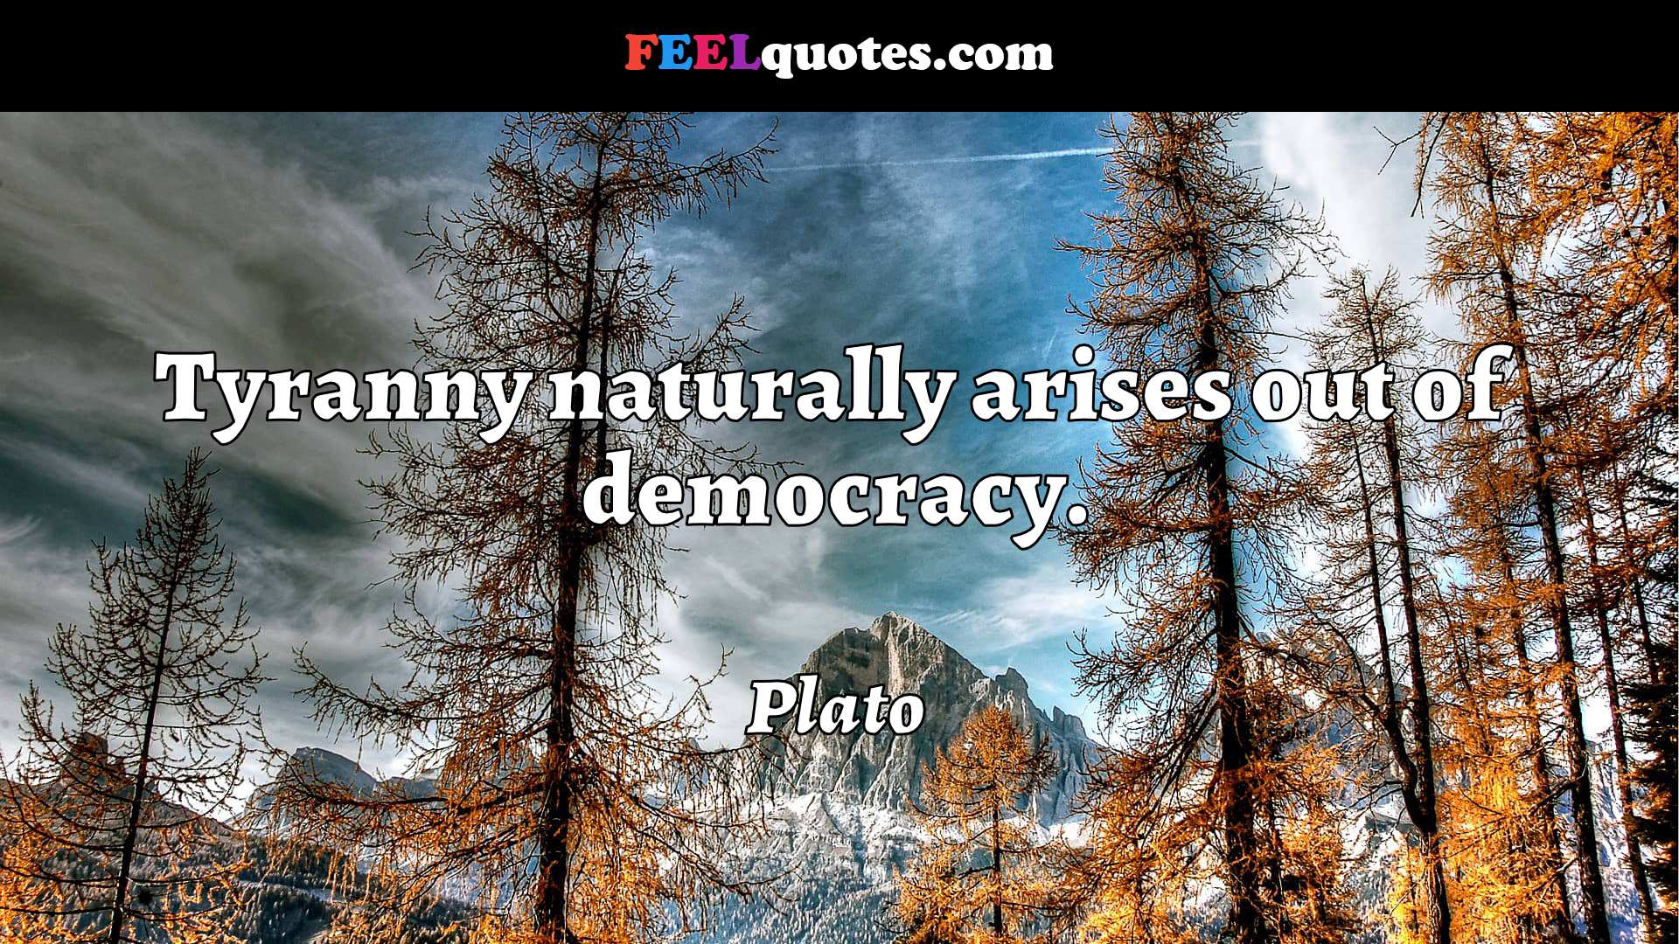
Plato Quotes

Slide 14
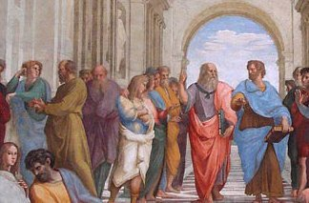
Next Week…Aristotle
This Photo by Unknown Author is licensed under CC BY
This Photo by Unknown Author is licensed under CC BY-SA

